Slide 1
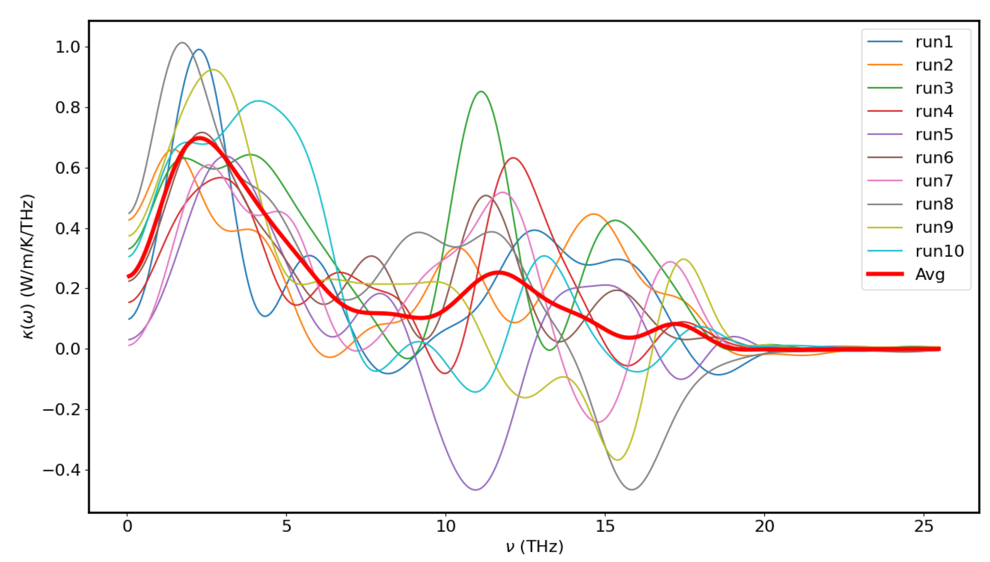
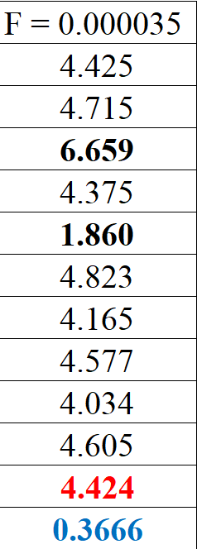
Temp 300K - F = 0.000035 with 10 runs

Slide 2
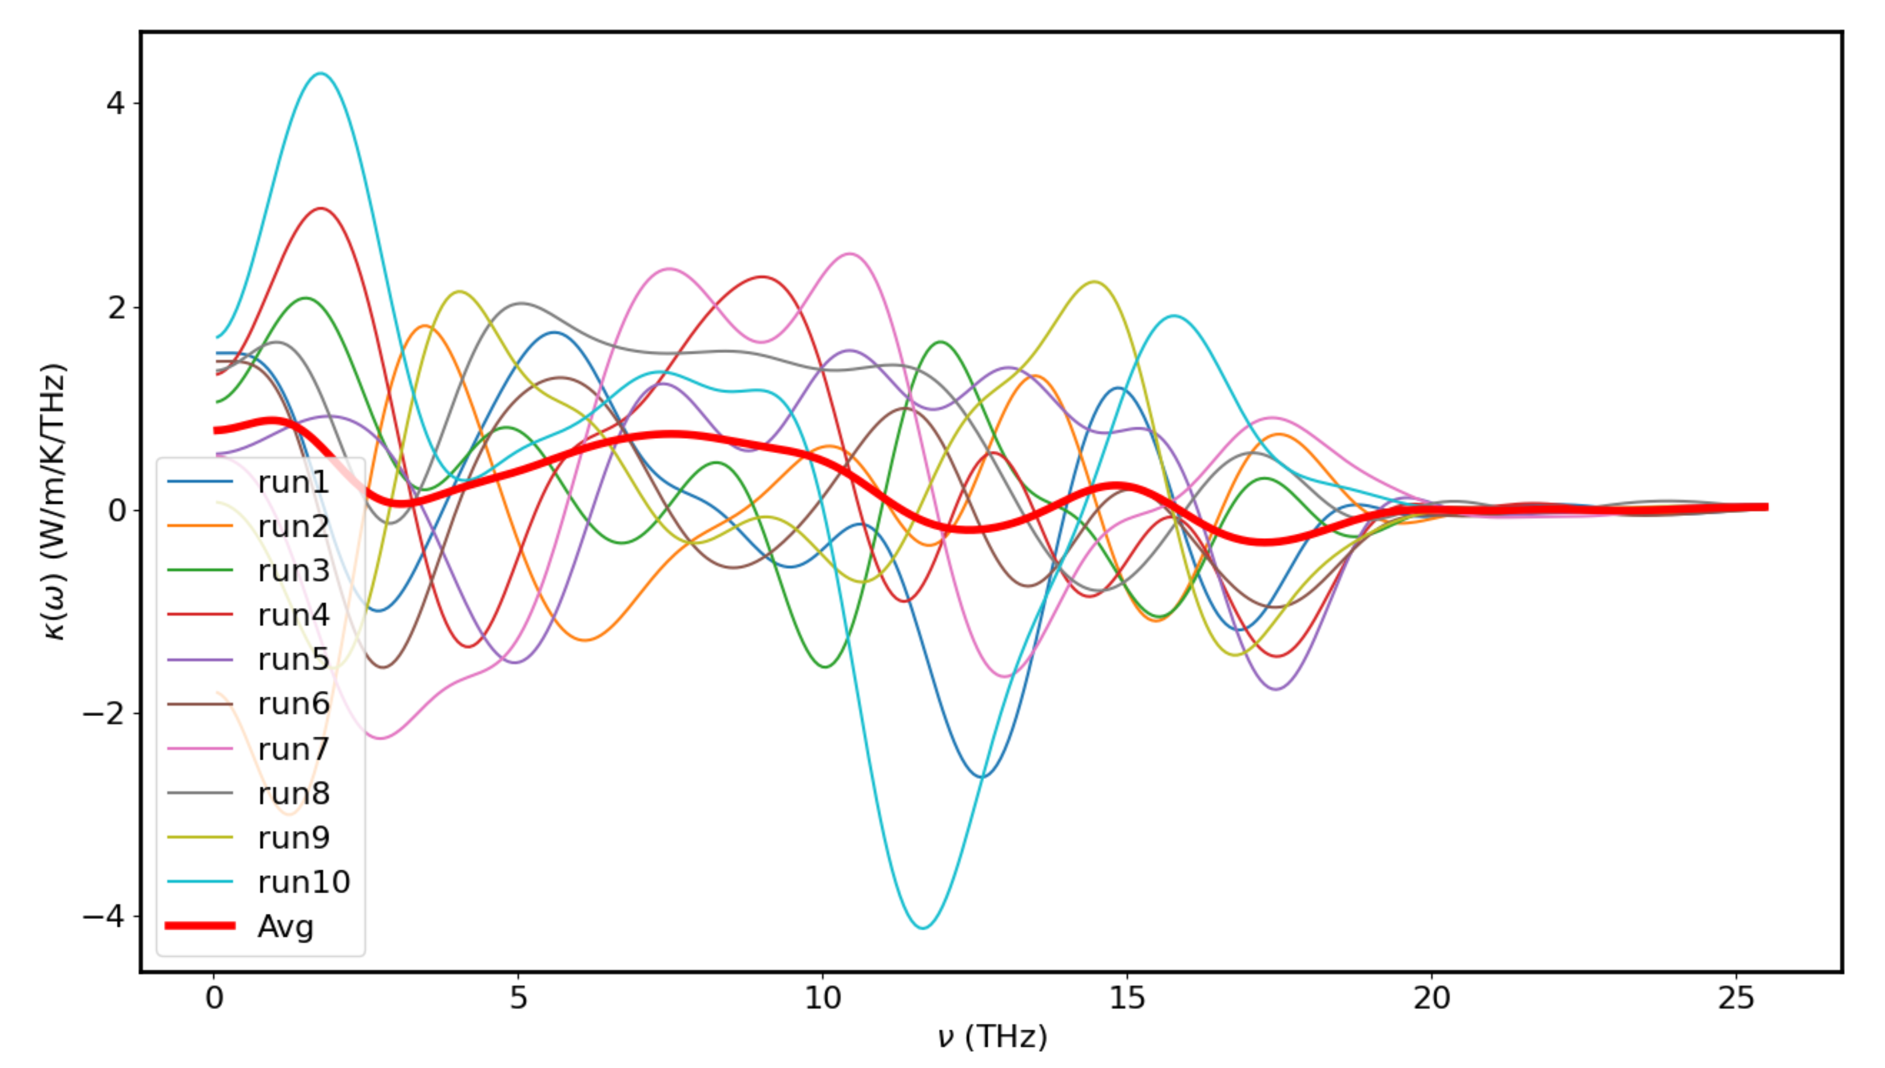
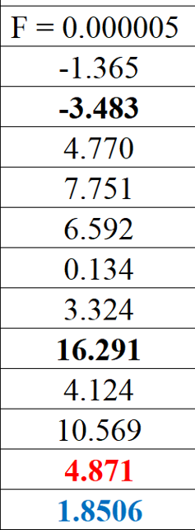
Temp 300K - F = 0.000005 with 10 runs

Slide 3
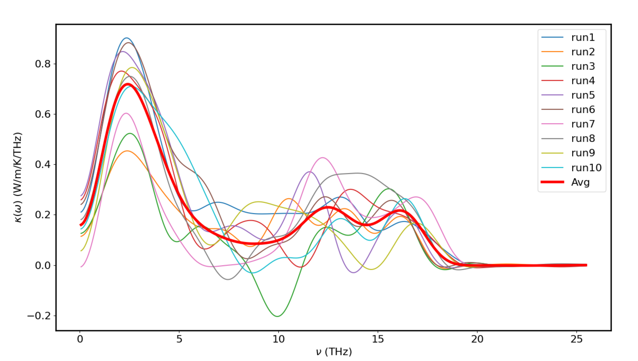
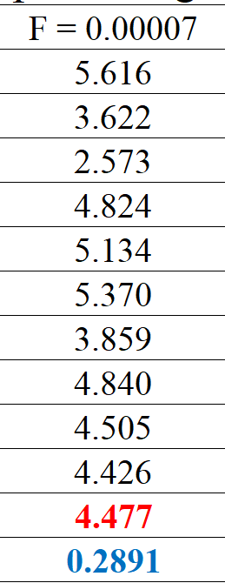
Temp 300K - F = 0.00007 with 10 runs

Slide 4
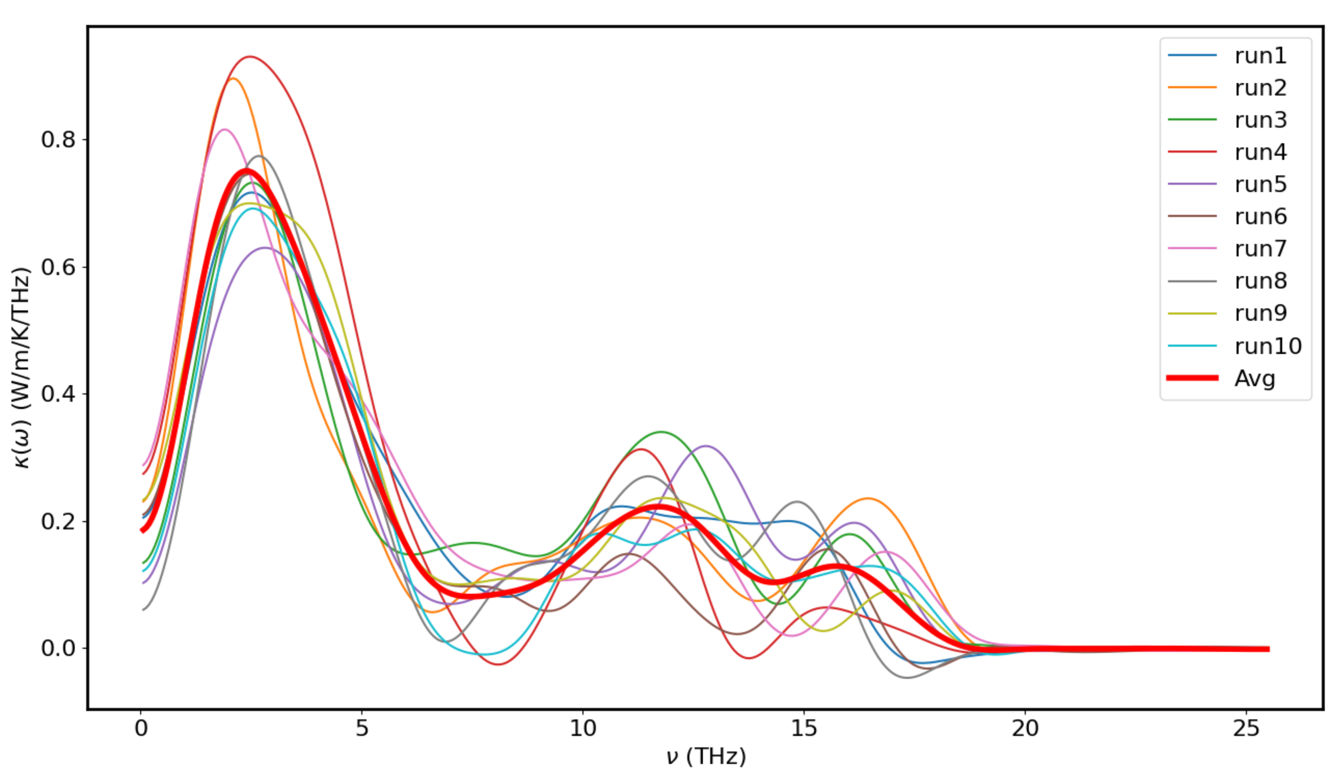
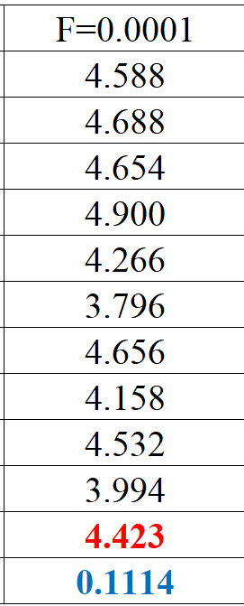
Temp 300K - F = 0.0001 with 10 runs

Slide 5
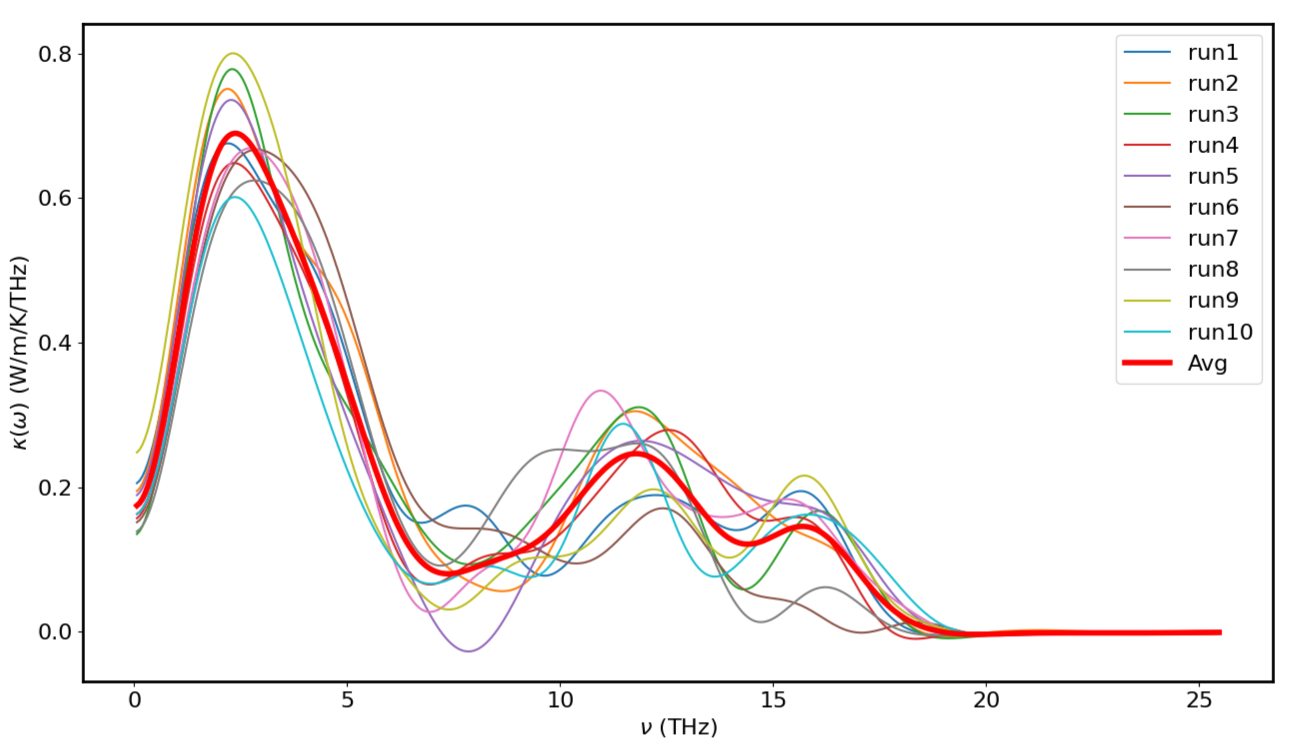
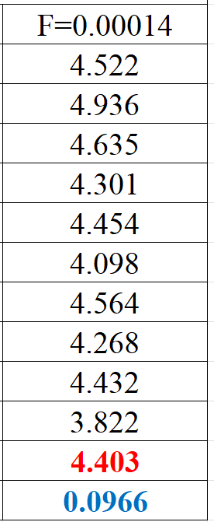
Temp 300K - F = 0.00014 with 10 runs

Slide 6
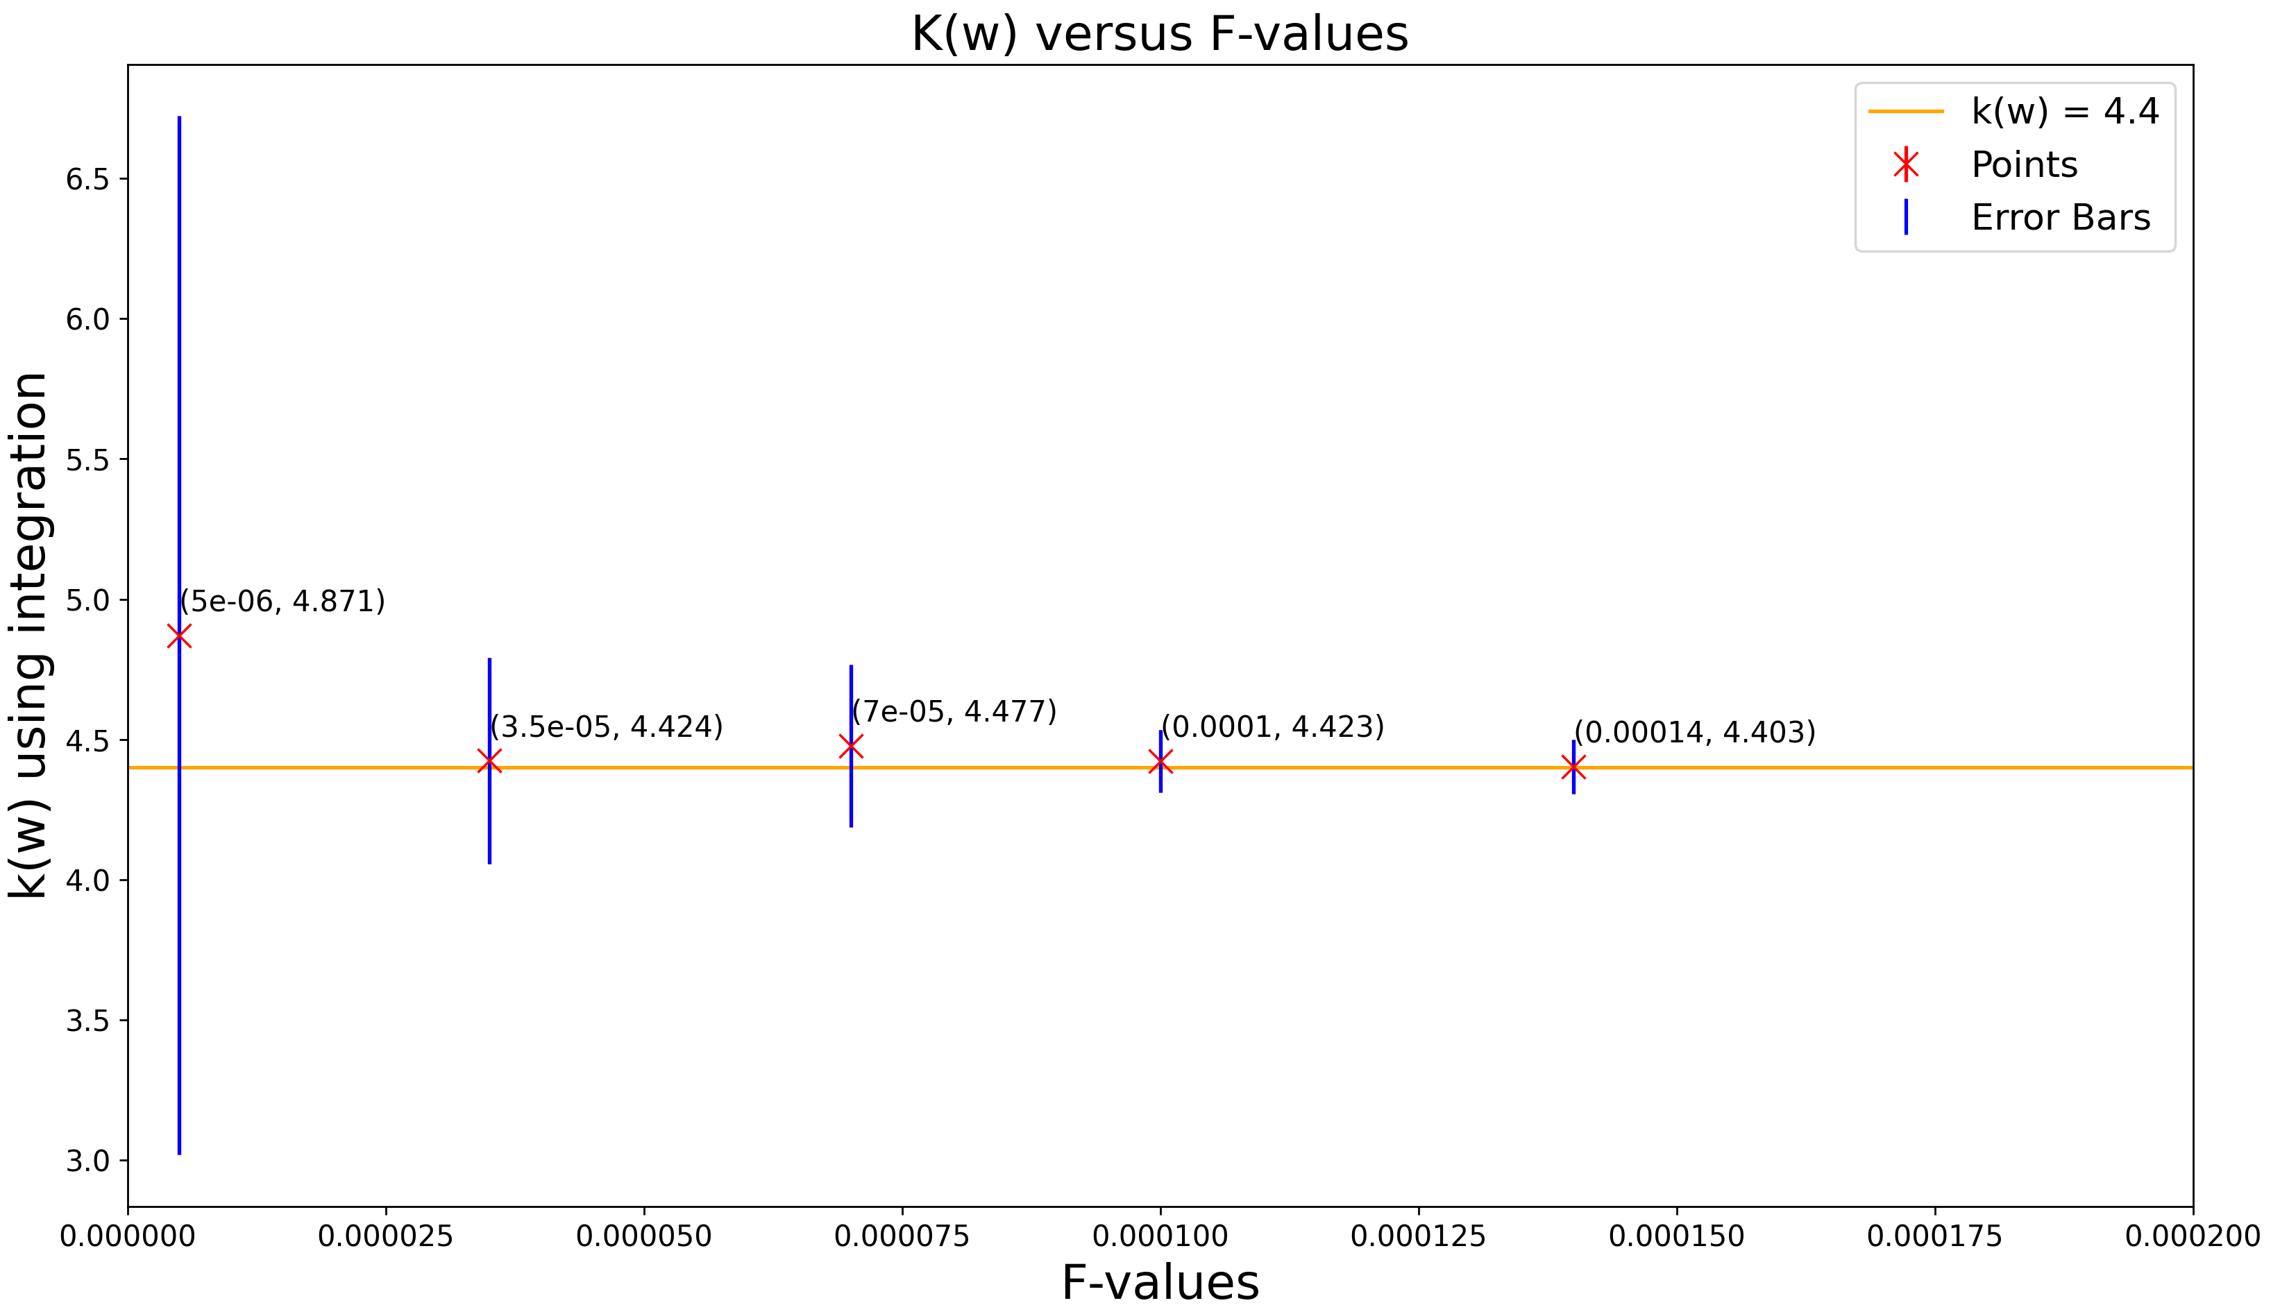
Plot of k(w) versus F-values at T=300K

Slide 7
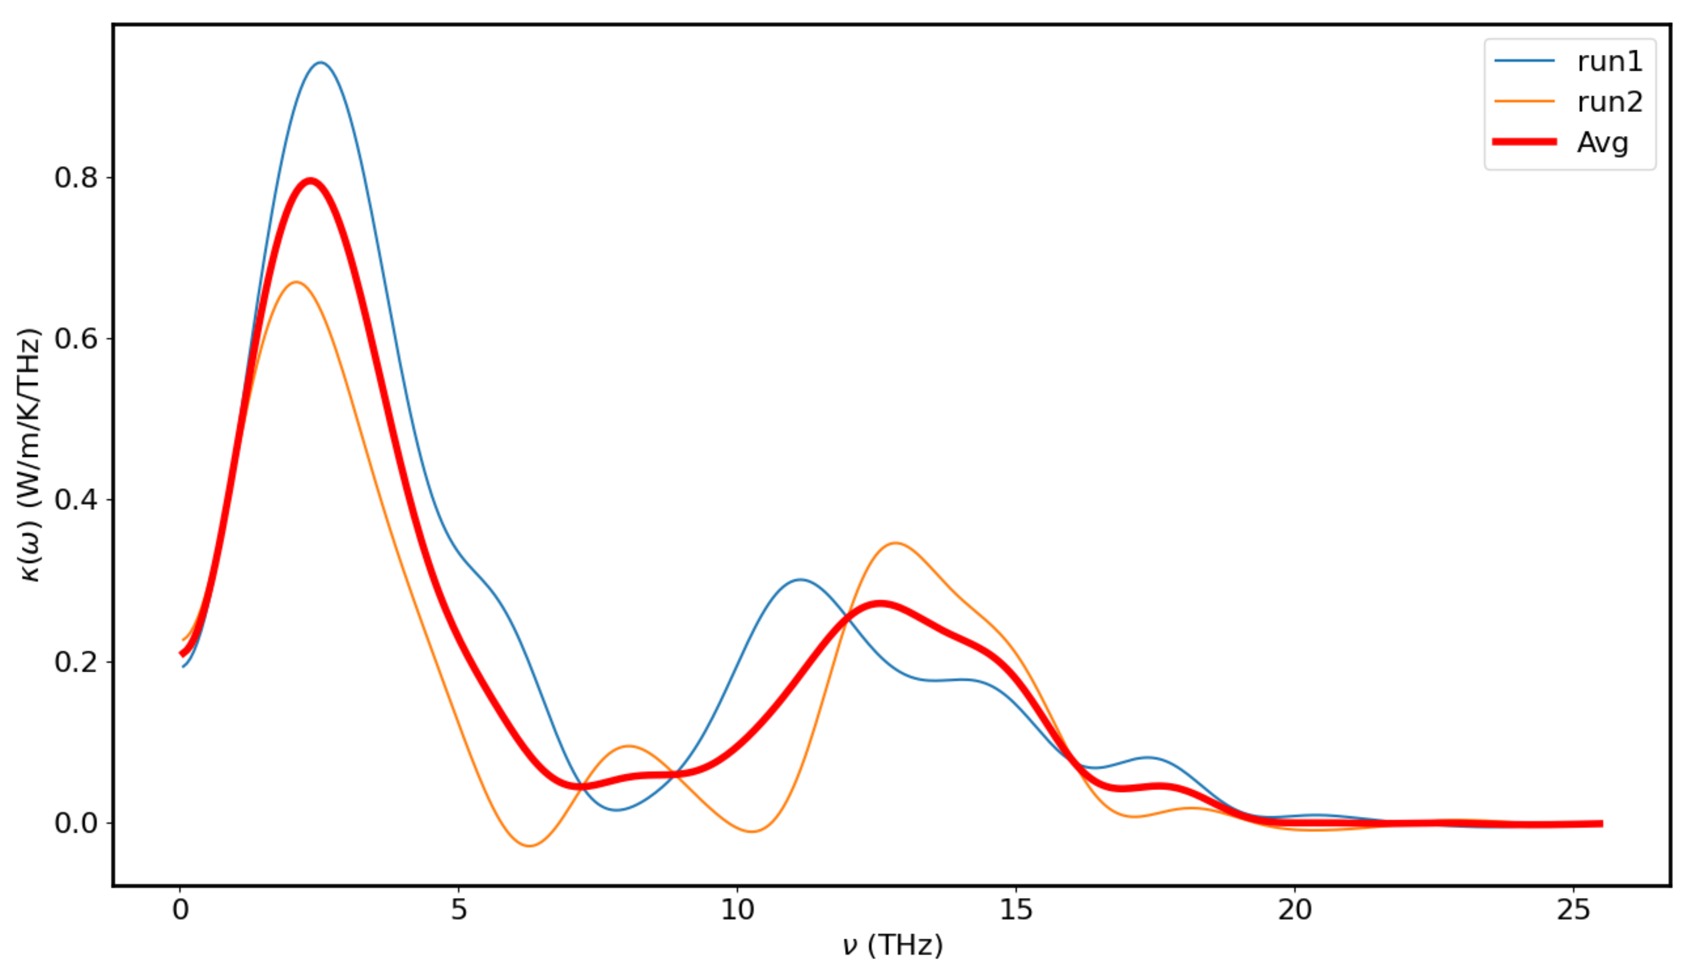
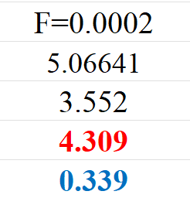
Temp 300K - F = 0.0002 with 2 runs

Slide 8
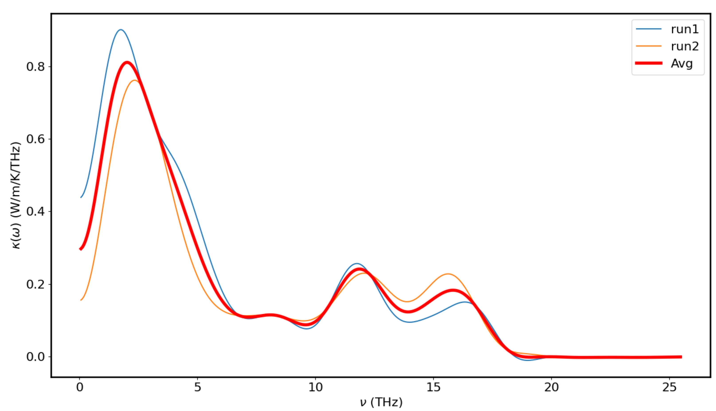
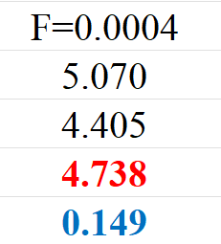
Temp 300K - F = 0.0004 with 2 runs

Slide 9
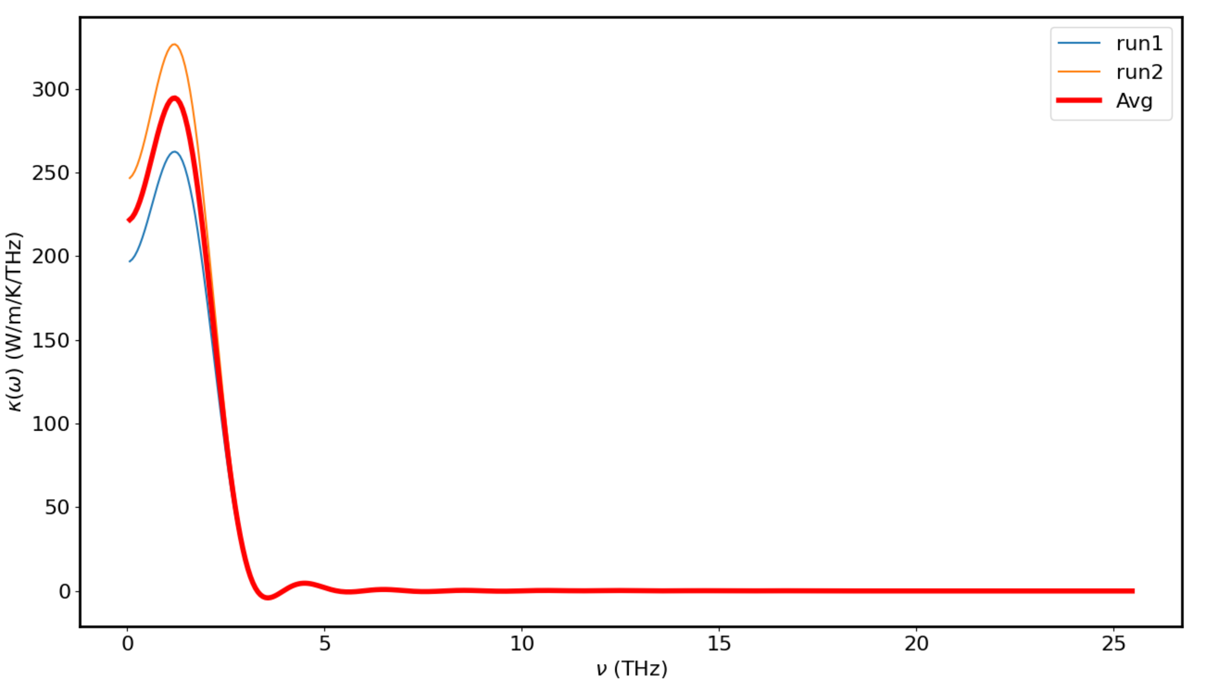
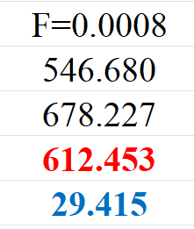
Temp 300K – F = 0.0008 with 2 runs

Slide 10
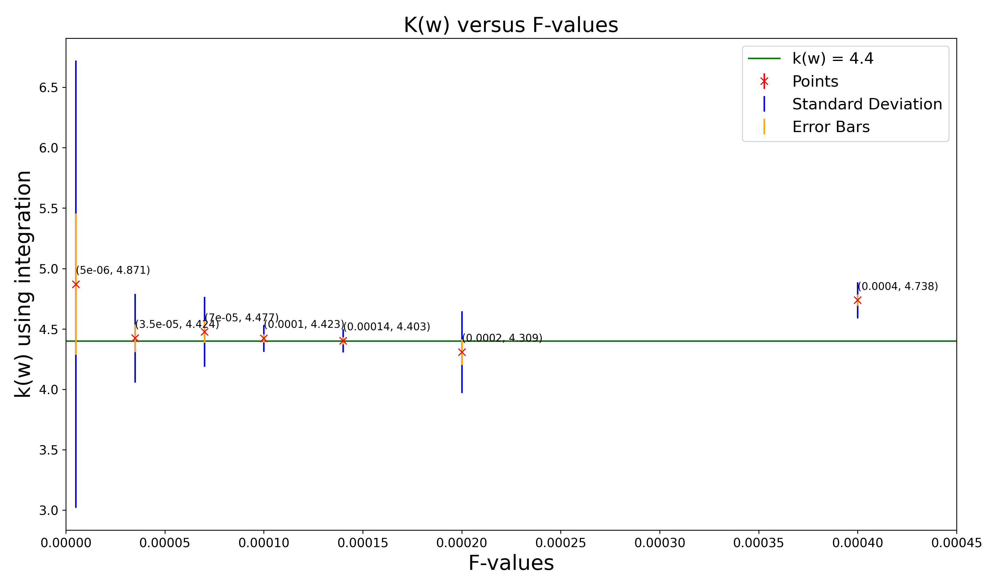
Plot of k(w) versus F-values for Temp = 300K

Slide 11
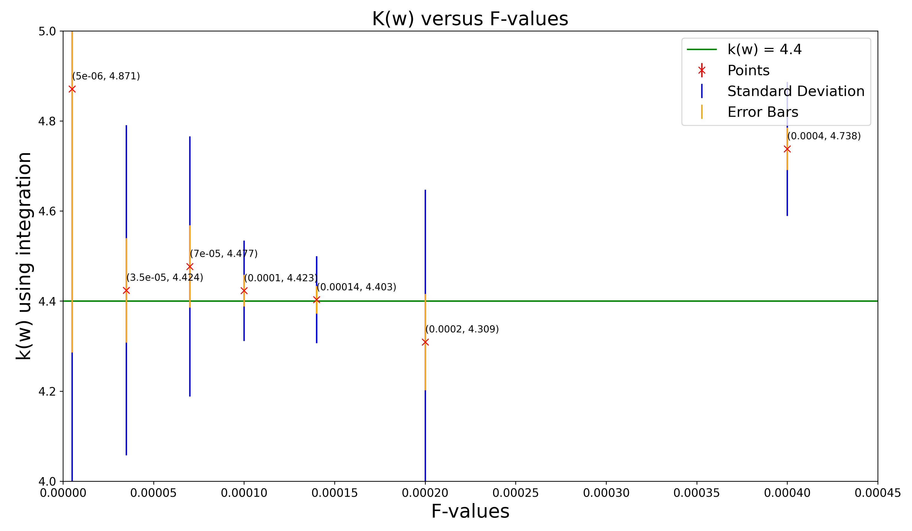
Plot of k(w) versus F-values for Temp = 300K (Zoom In)

Slide 12
Temp 300K – F = 0.00014 with 10 runs

Slide 13
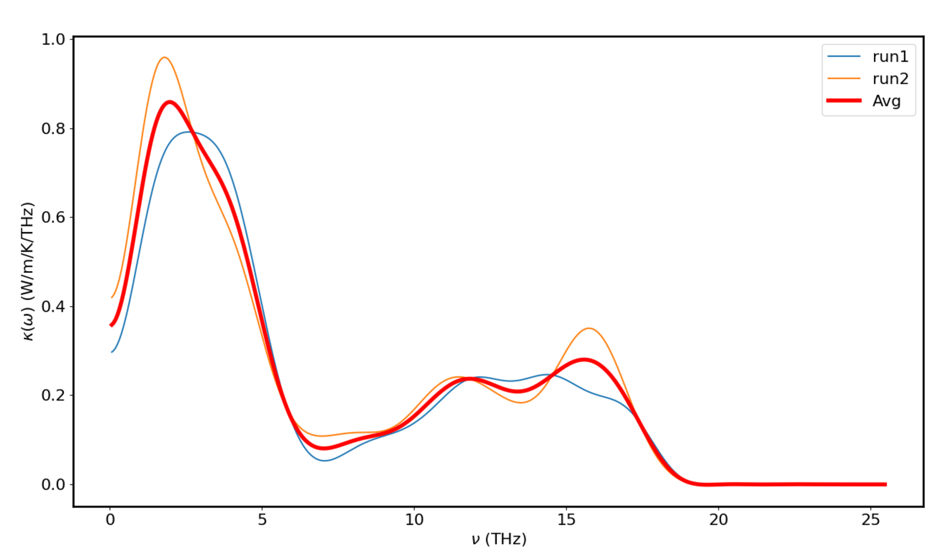
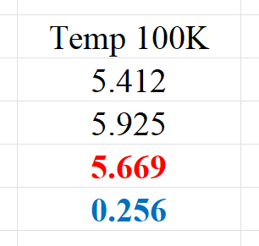
Temp 100K - Plot for F = 0.00014 with 2 runs

Slide 14
Temp 300K - Plot for F = 0.00014 with 10 runs

Slide 15
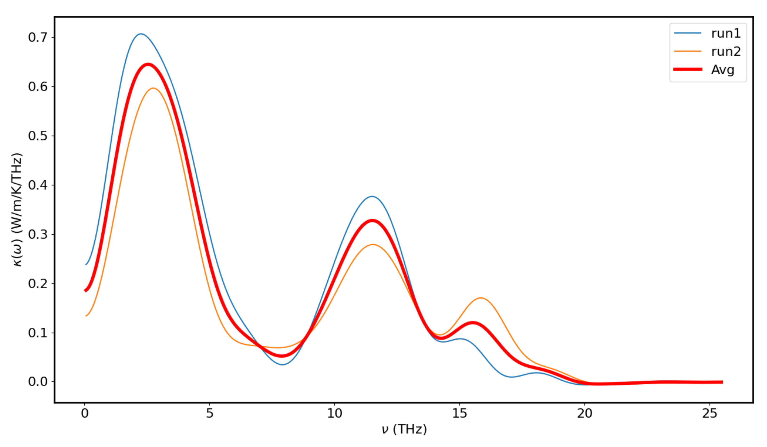
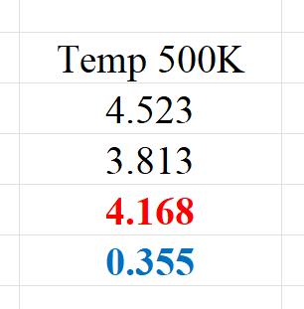
TEMP 500K - Plot for F = 0.00014 with 2 runs

Slide 16
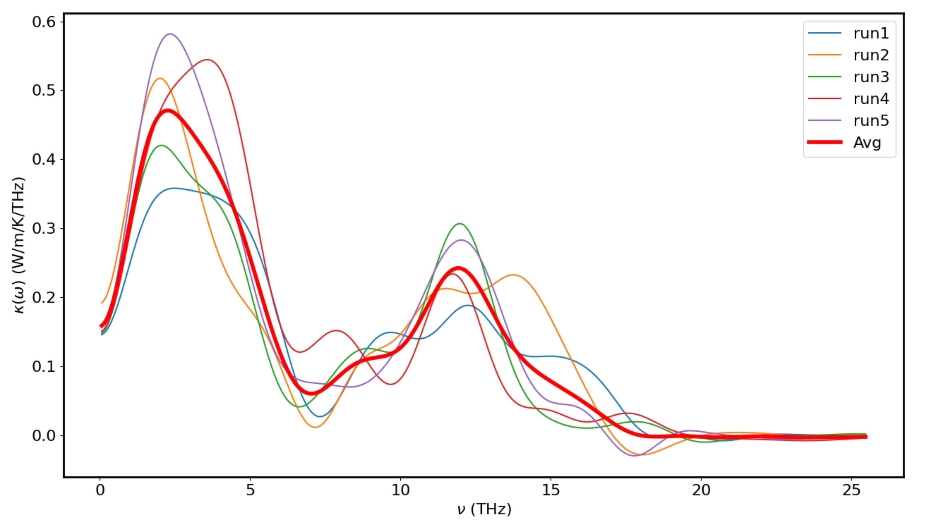
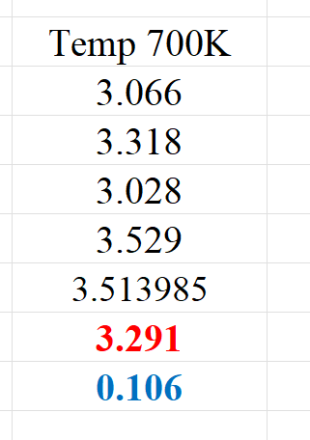
TEMP 700K - Plot for F = 0.00014 with 5 runs

Slide 17
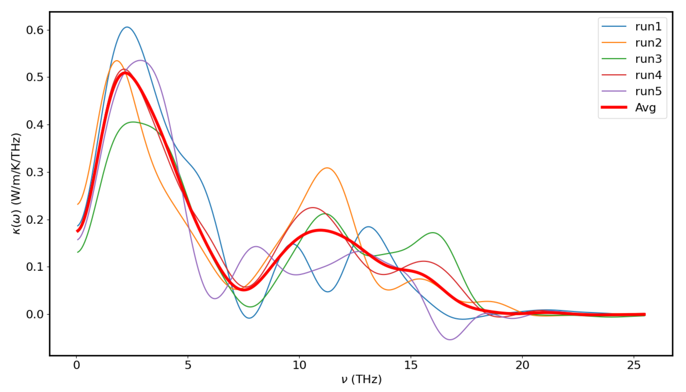
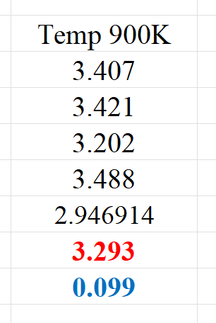
TEMP 900K - Plot for F = 0.00014 with 5 runs

Slide 18
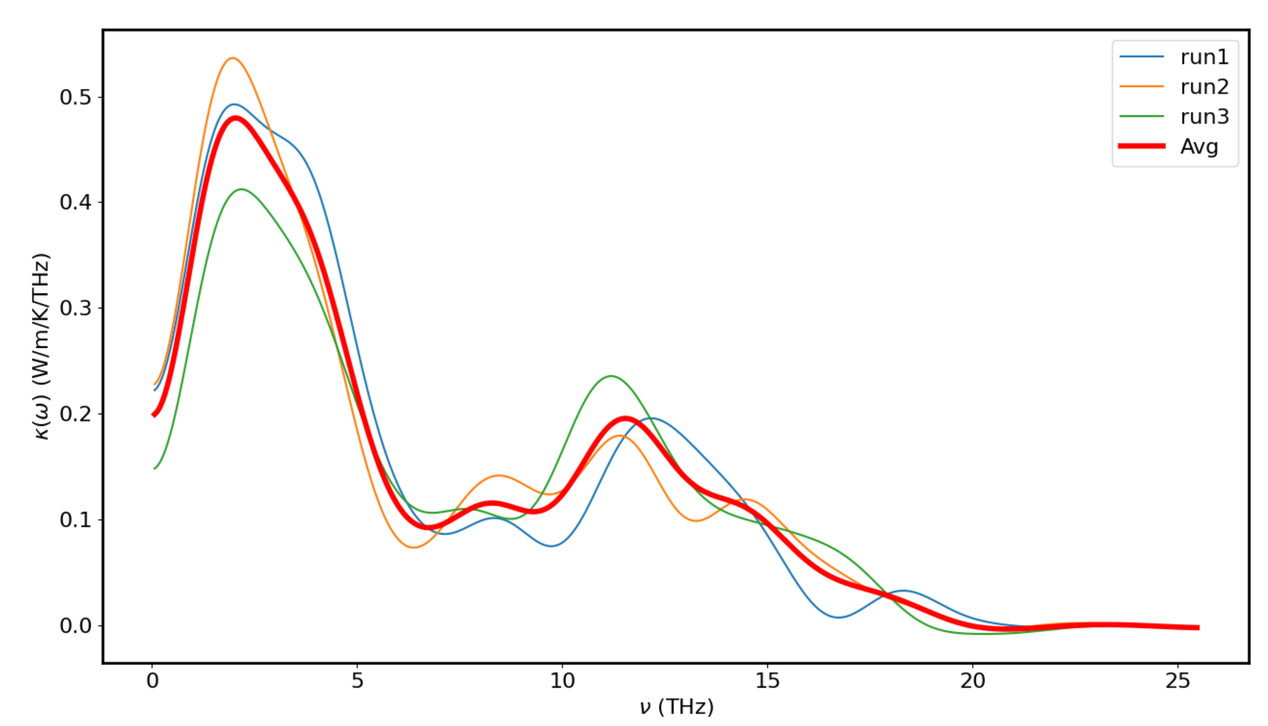
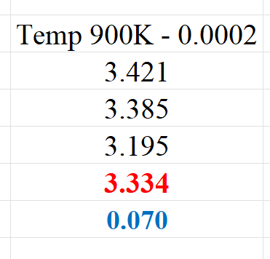
TEMP 900K - Plot for F = 0.0002 with 3 runs

Slide 19
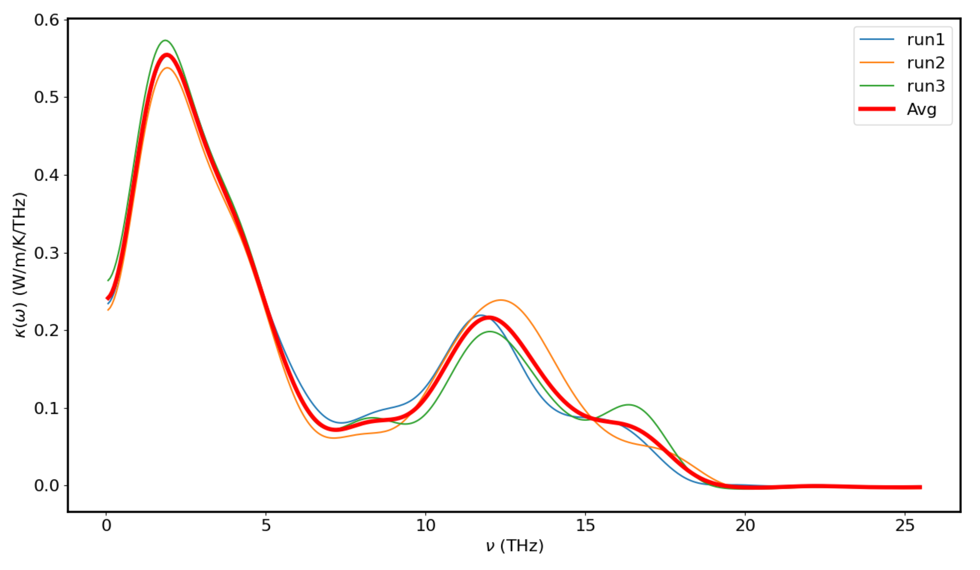
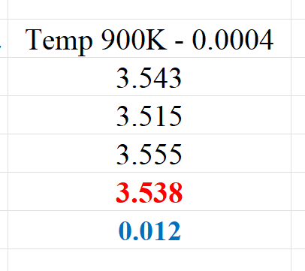
TEMP 900K - Plot for F = 0.0004 with 3 runs

Slide 20
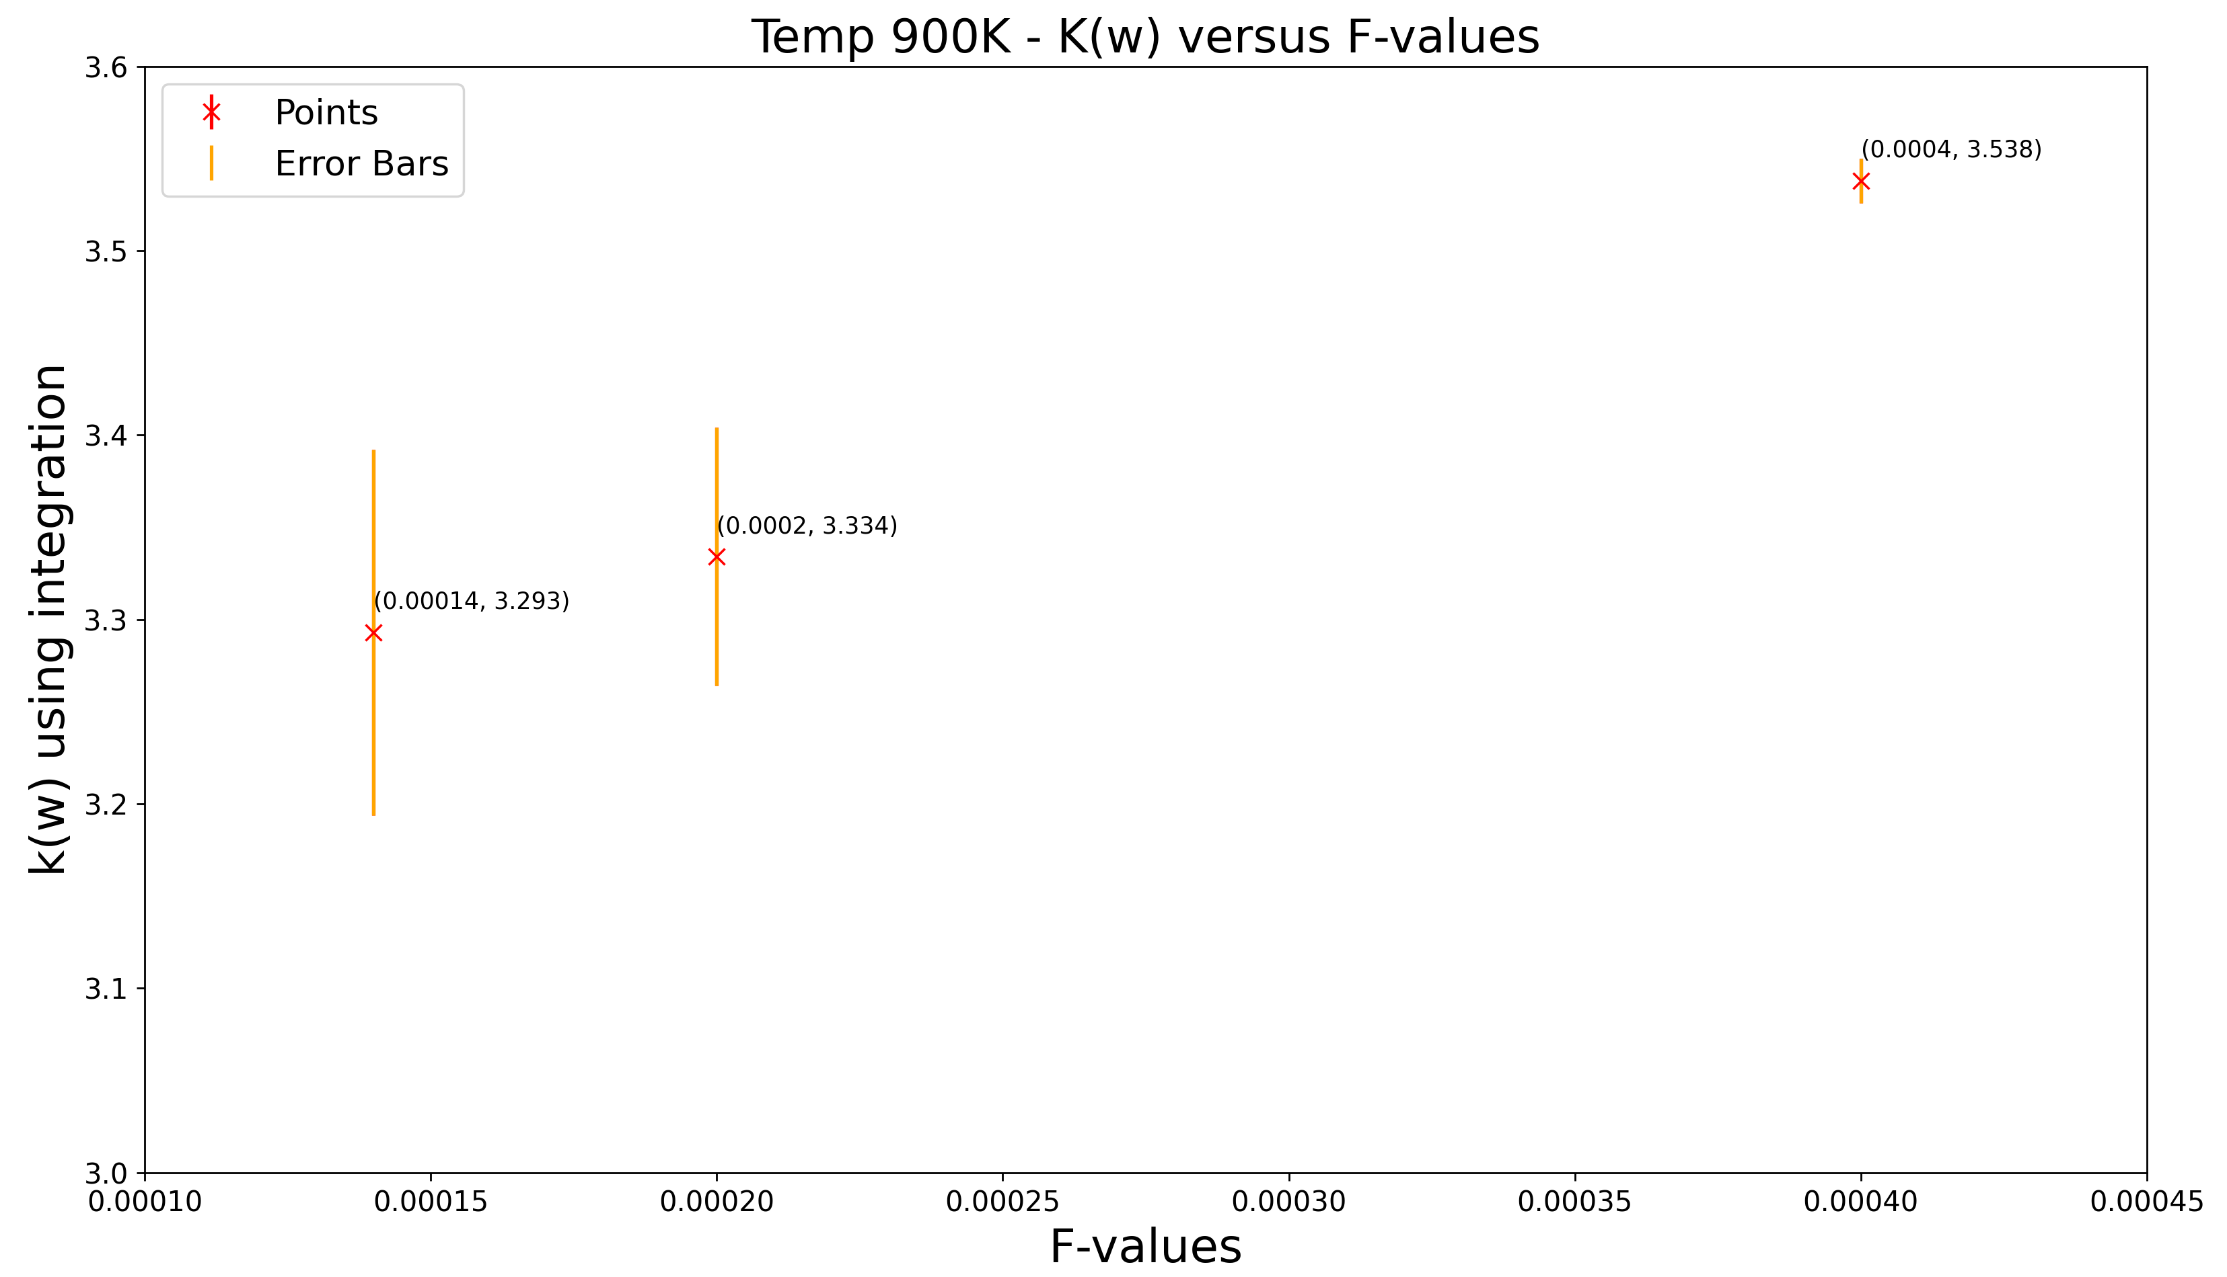
Plot of k(w) versus F-values for Temp = 900K

Slide 21
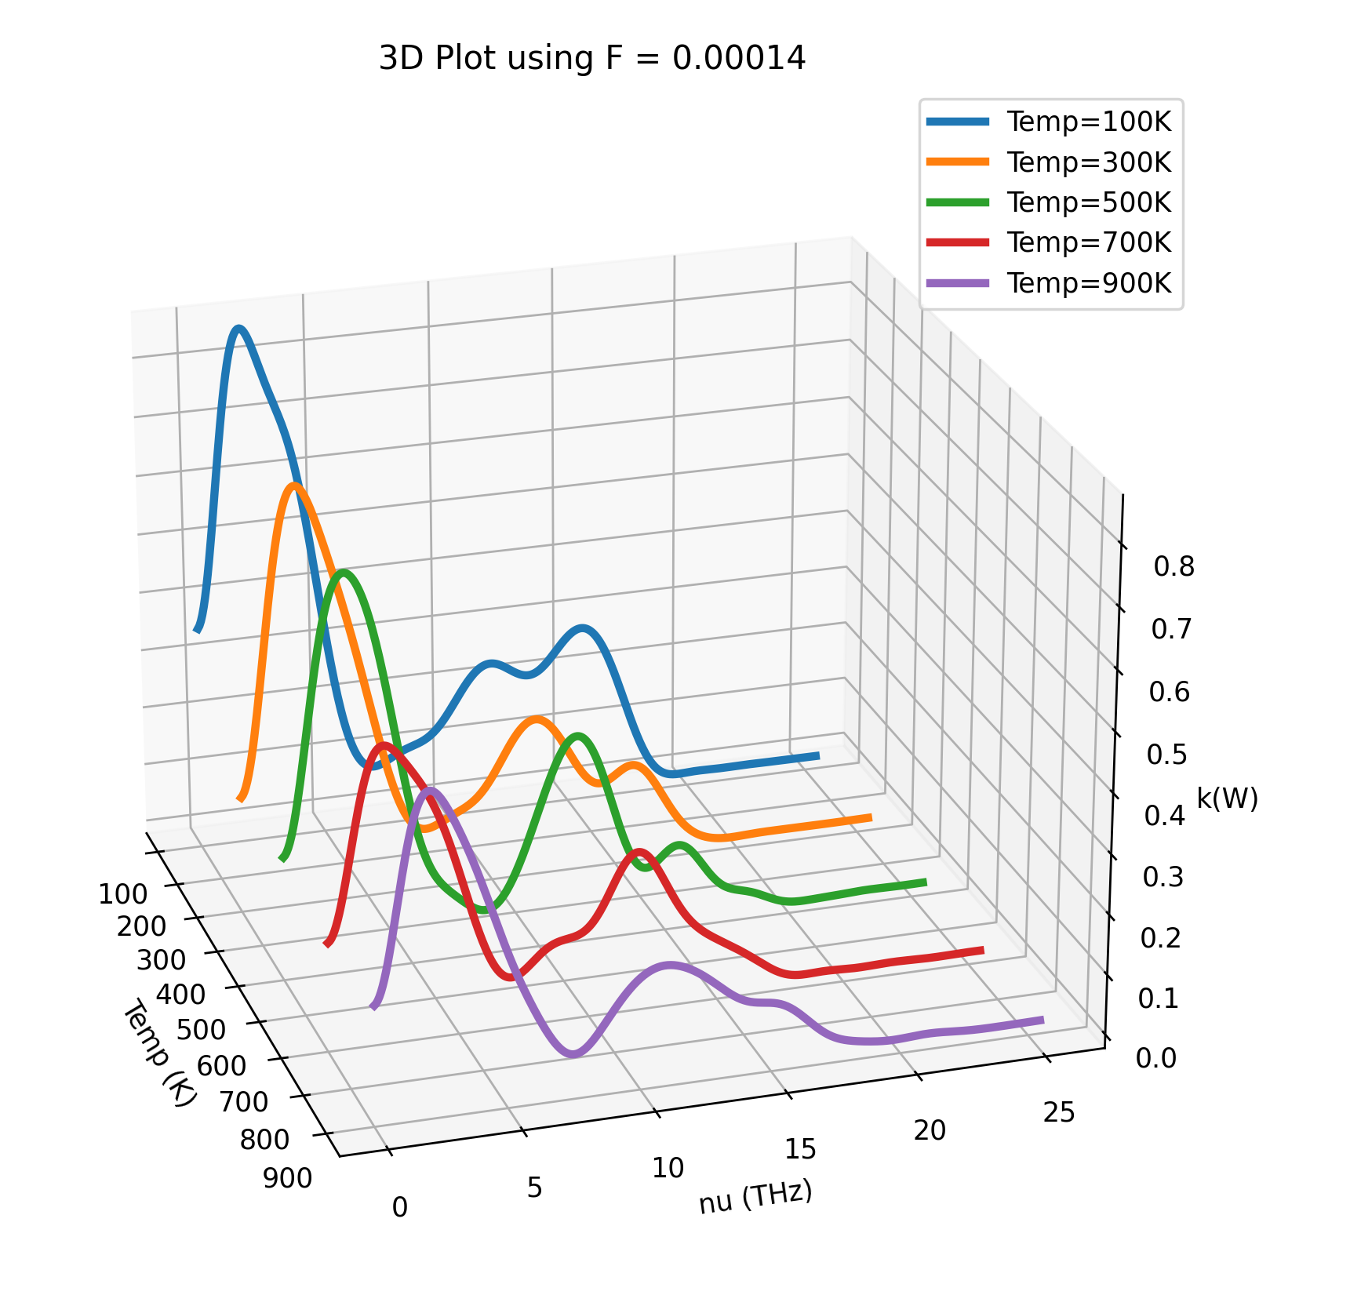
3D Plot of k(w) versus Temp(K) using F = 0.00014

Slide 22
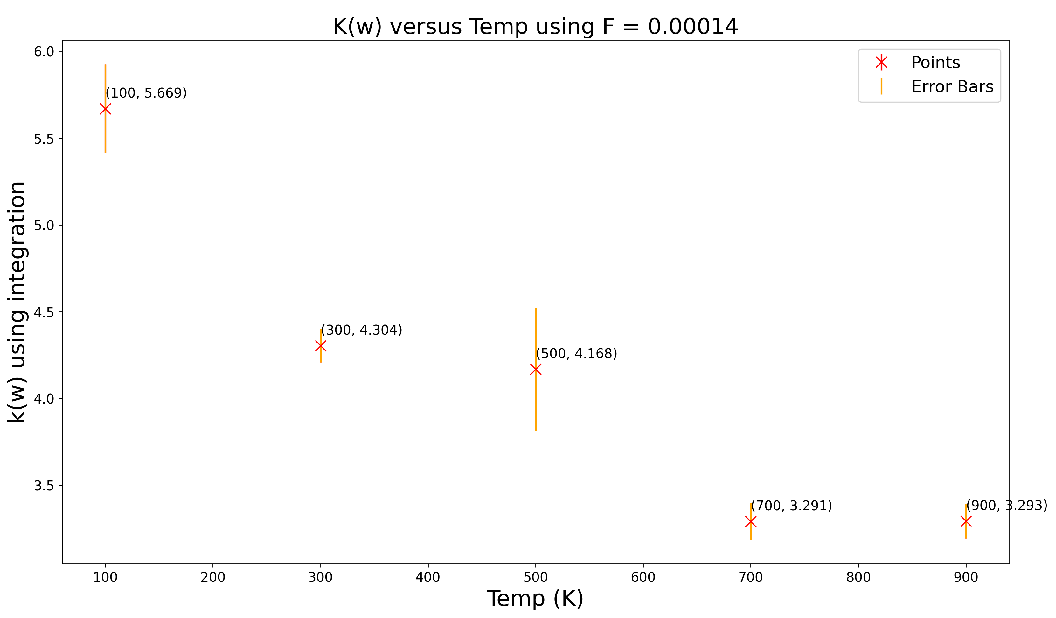
Plot of k(w) versus Temp(K) with F = 0.00014

Slide 23
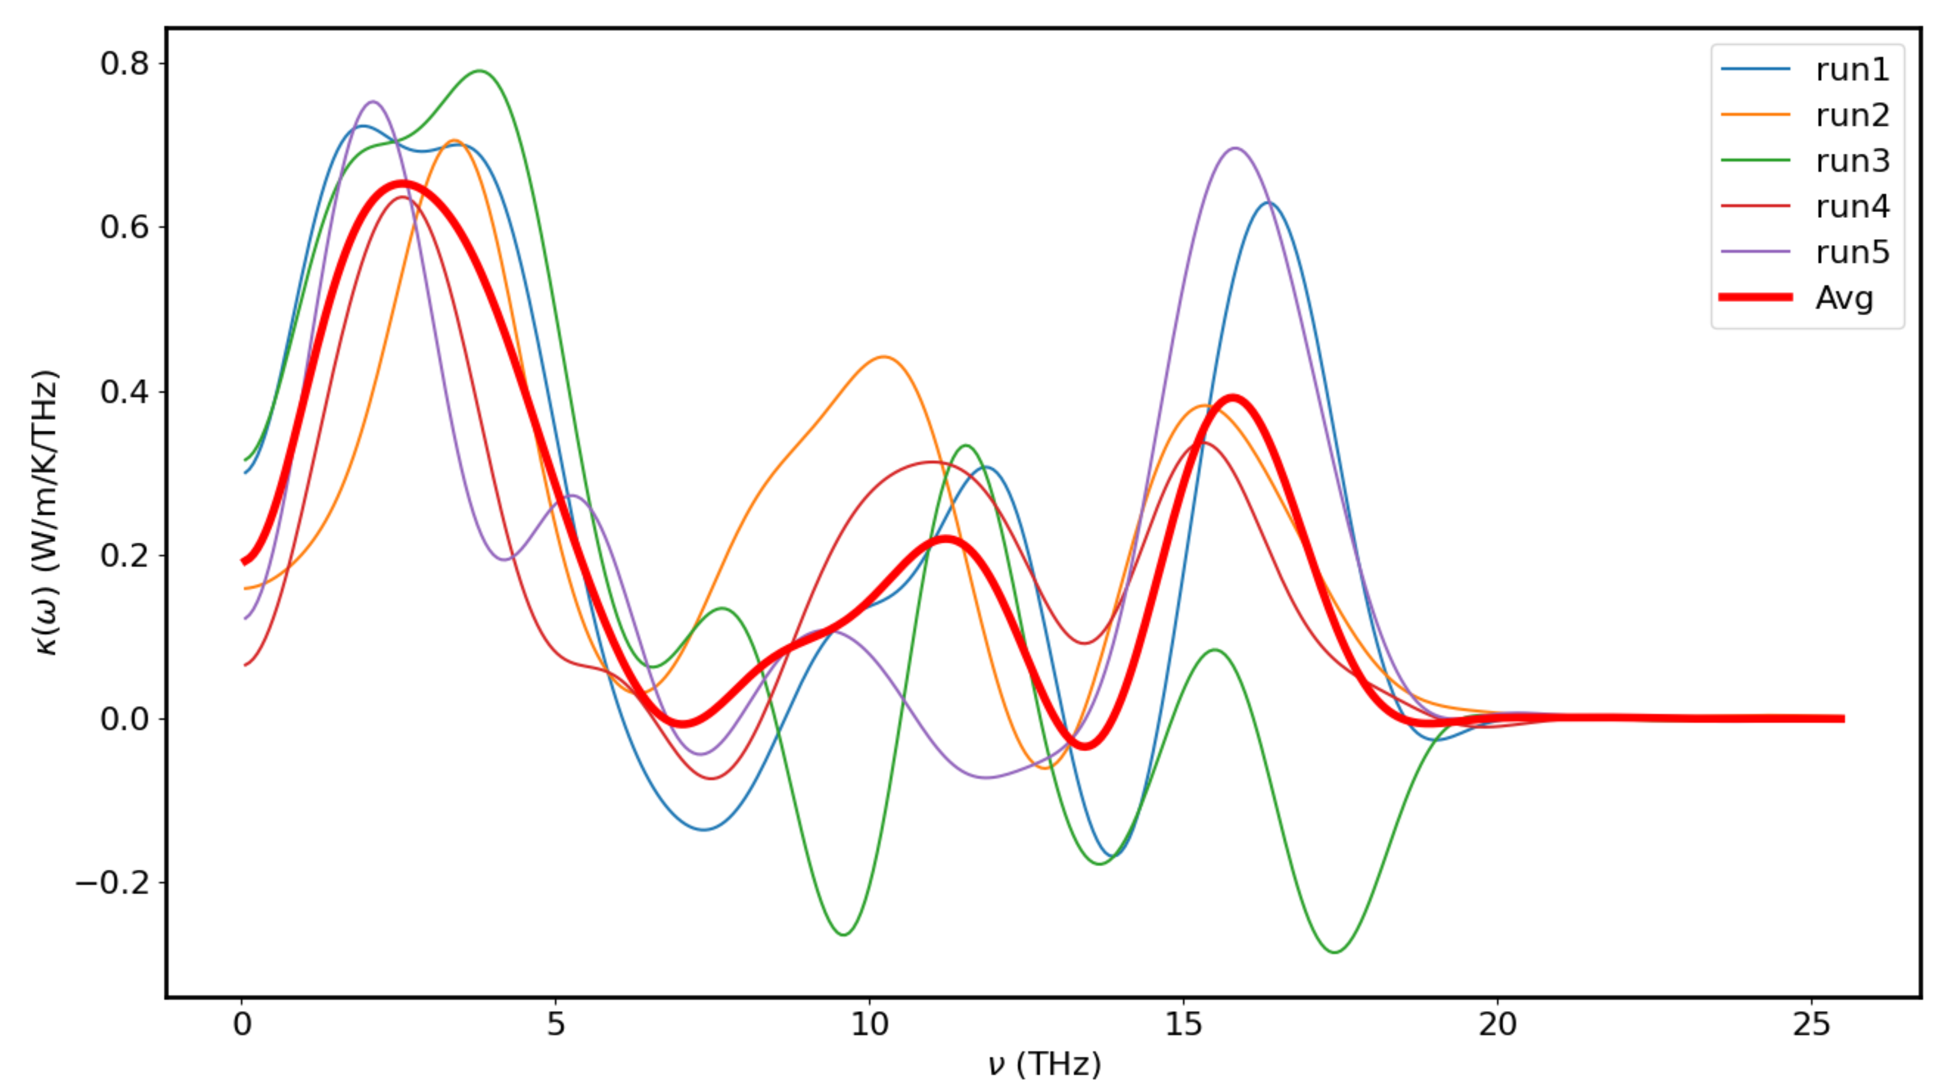
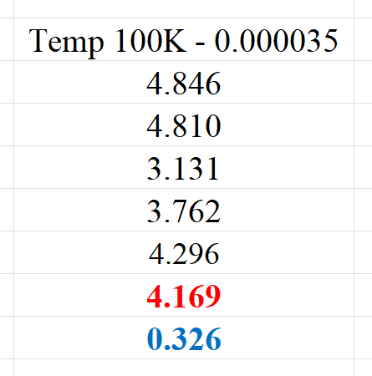
Temp 100K – F = 0.000035

Slide 24
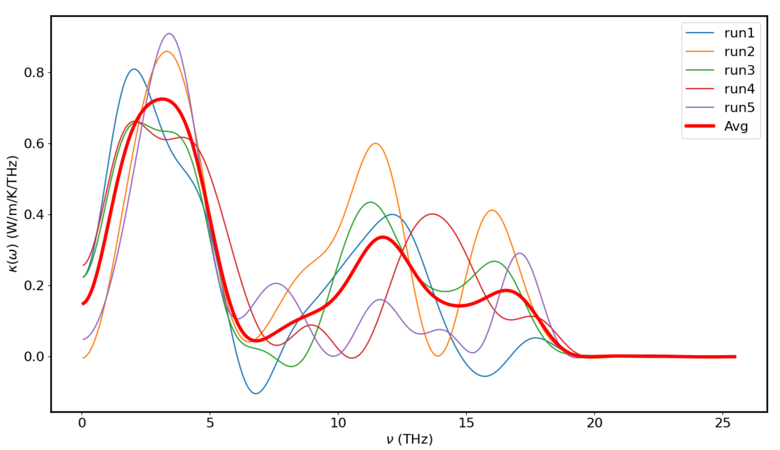
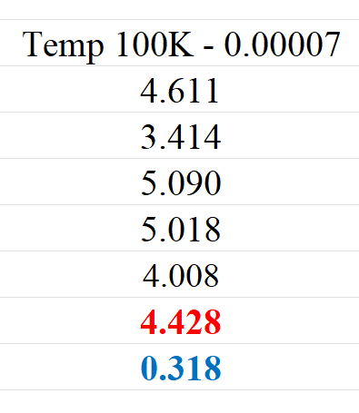
Temp 100K – F = 0.00005

Slide 25
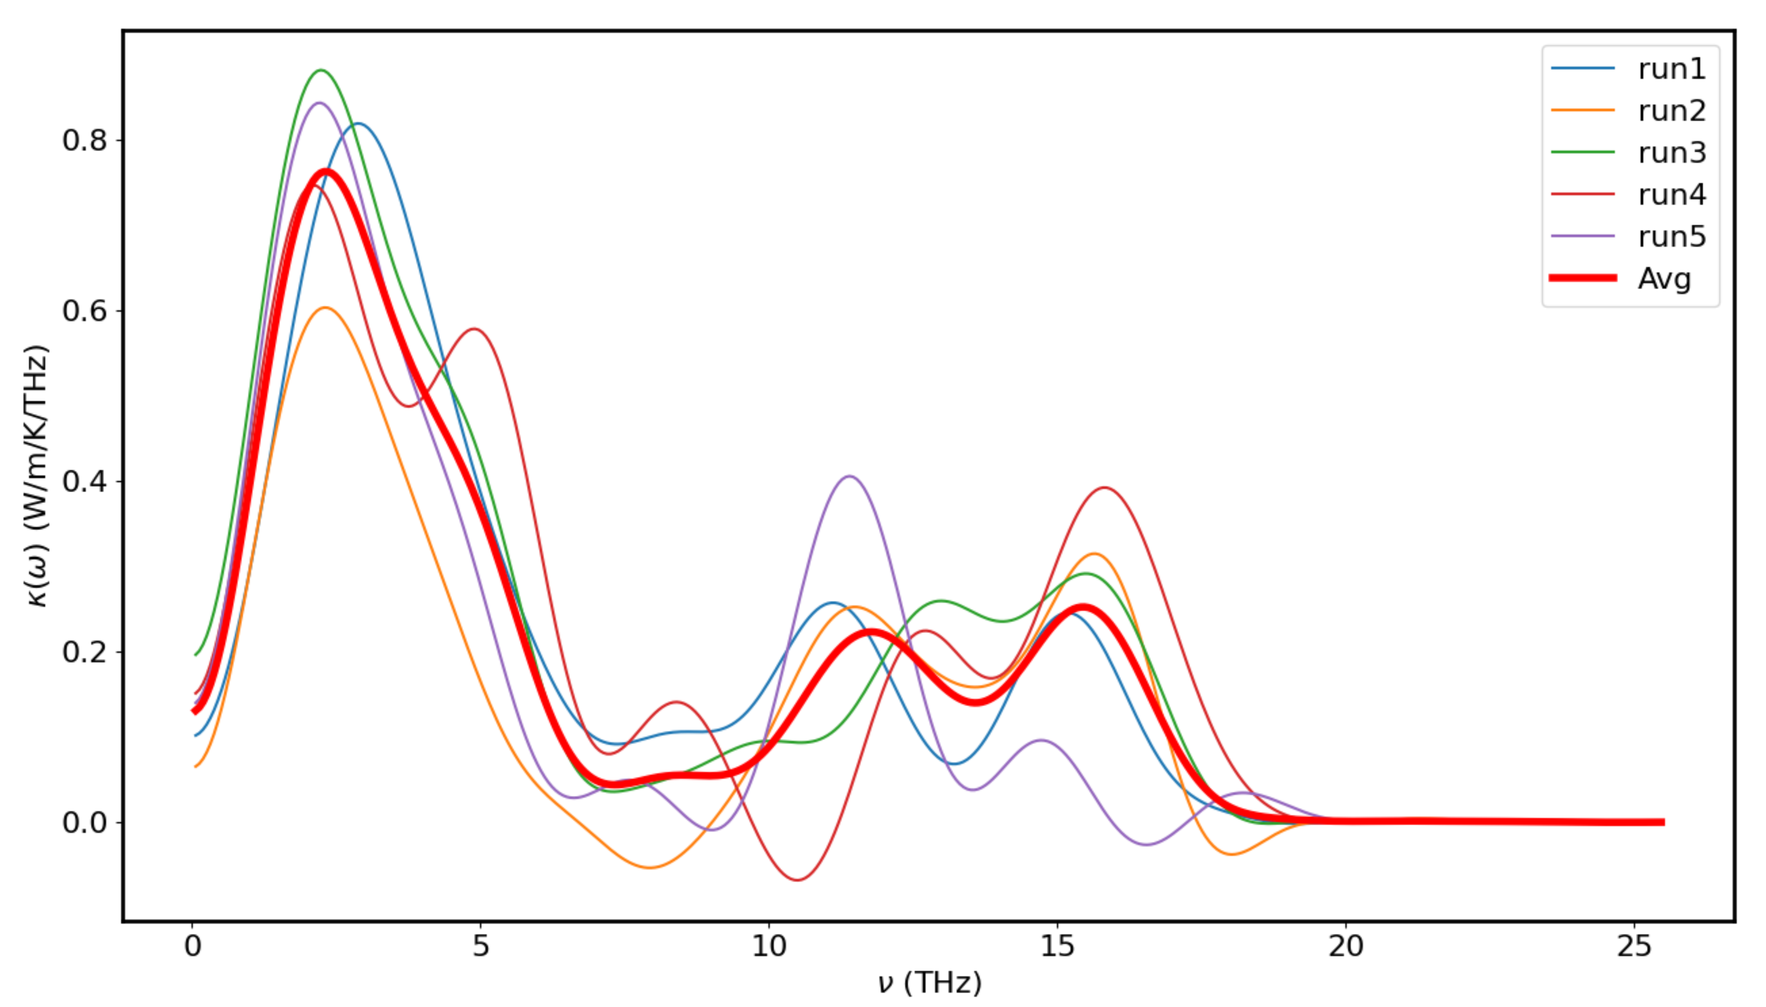
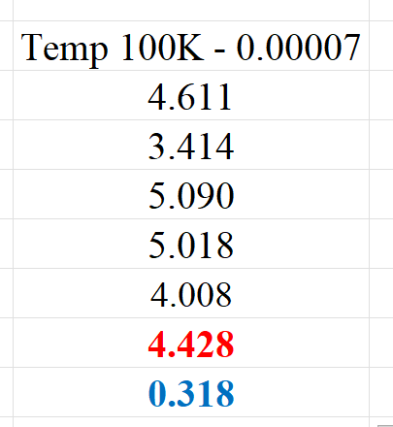
Temp 100K – F = 0.00007

Slide 26
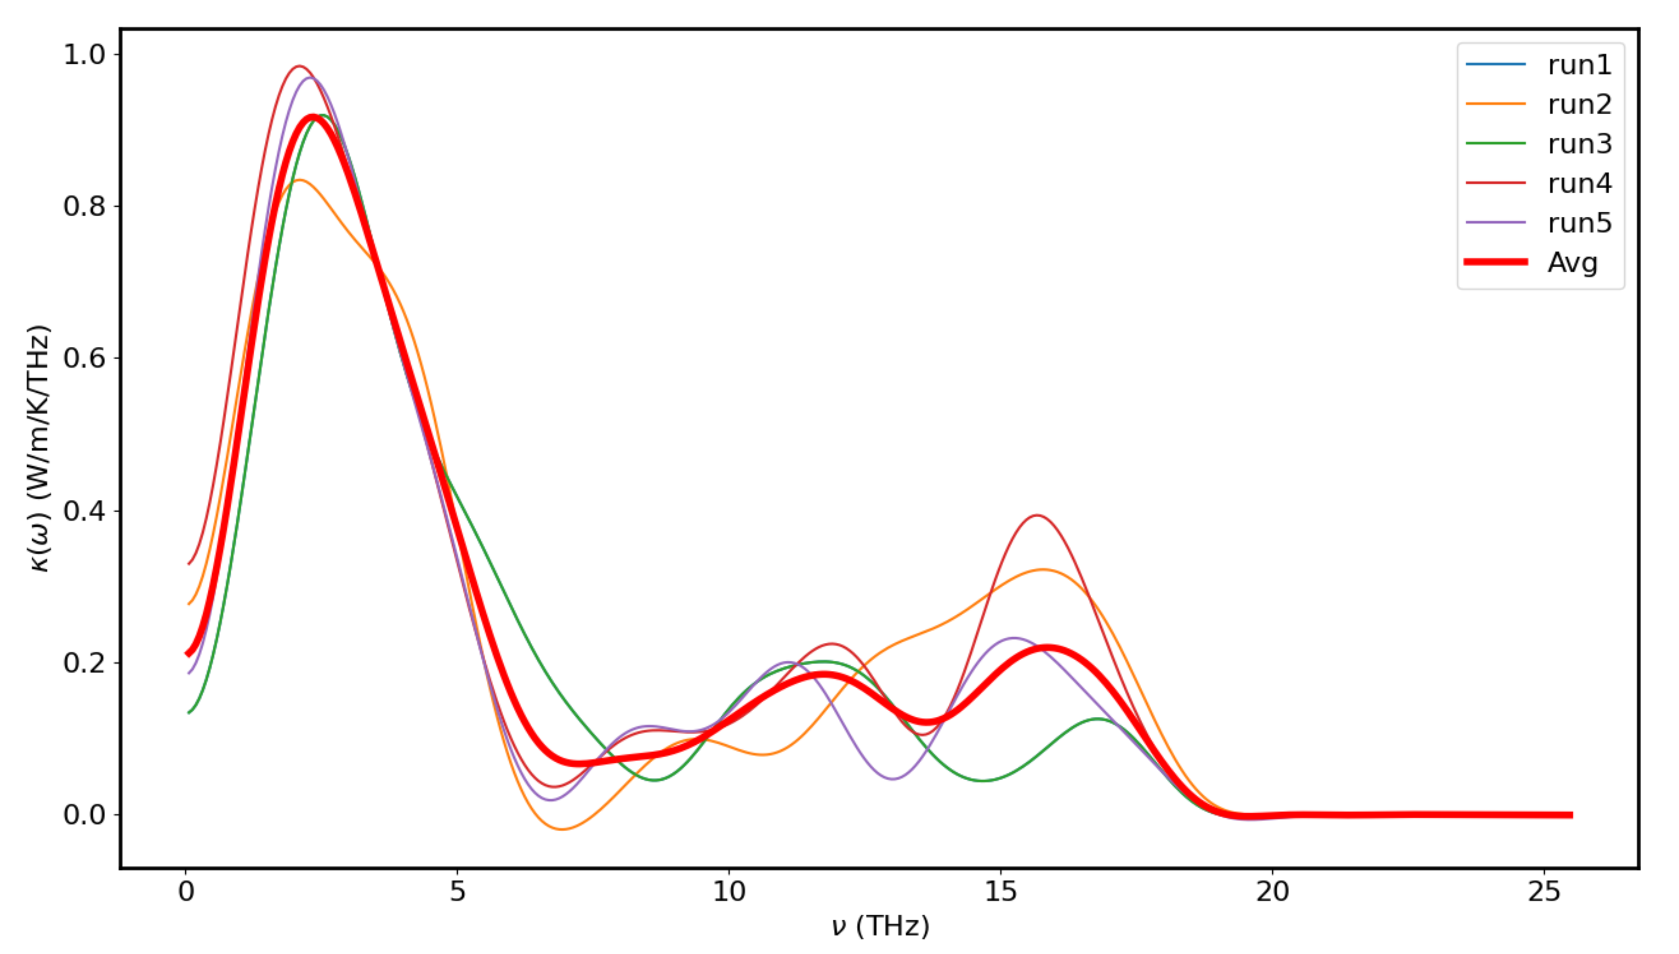
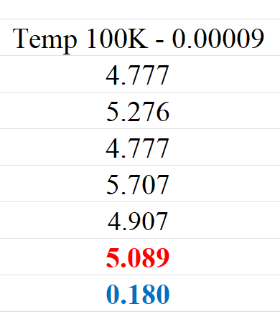
Temp 100K – F = 0.00009

Slide 27
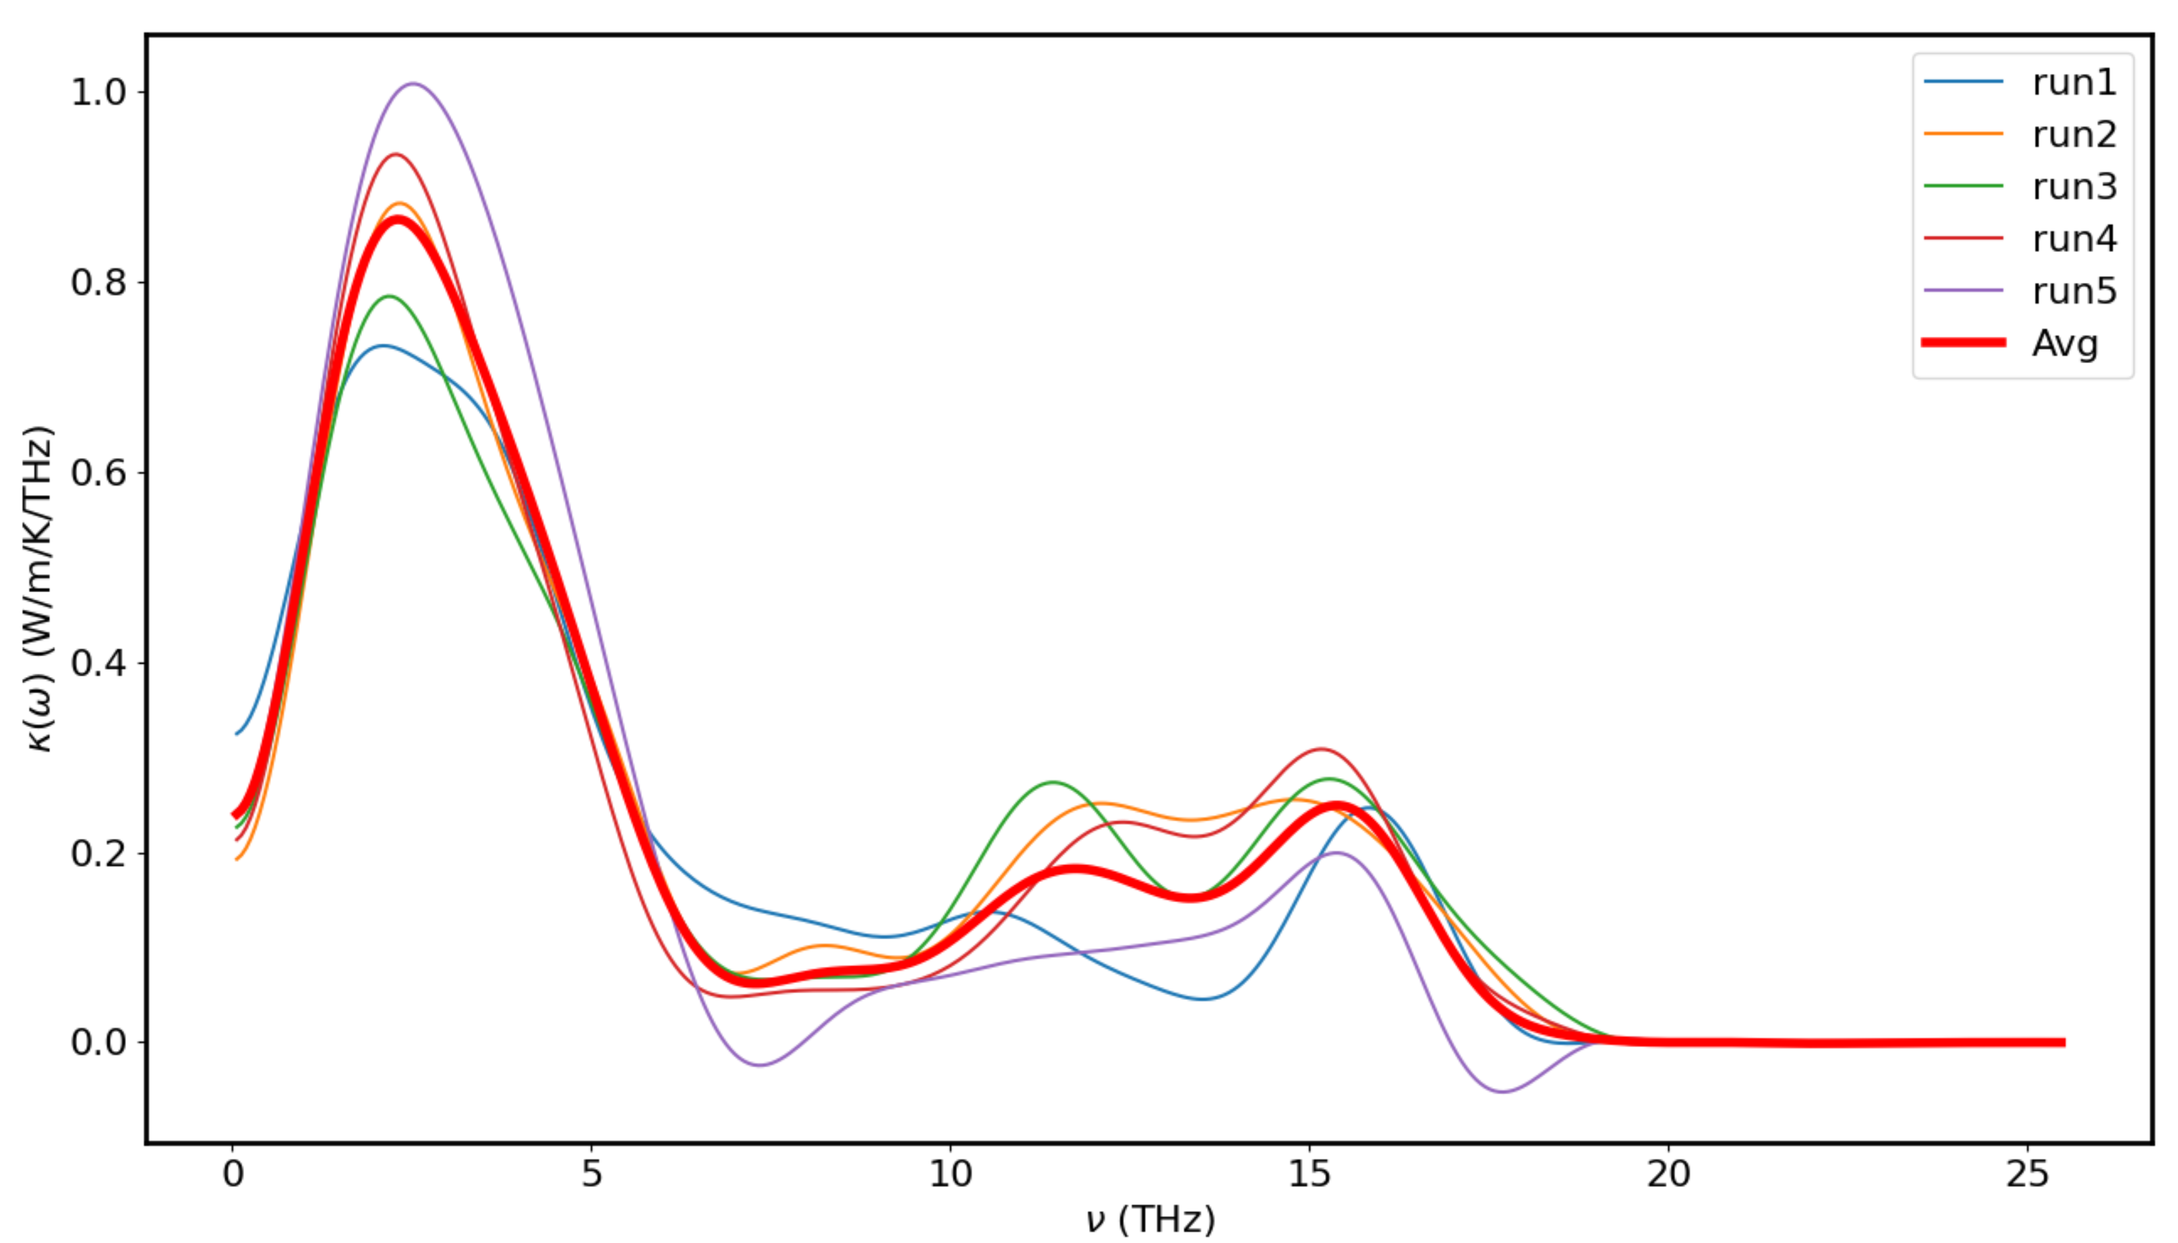
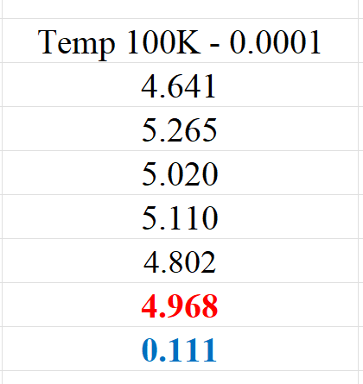
Temp 100K – F = 0.0001

Slide 28
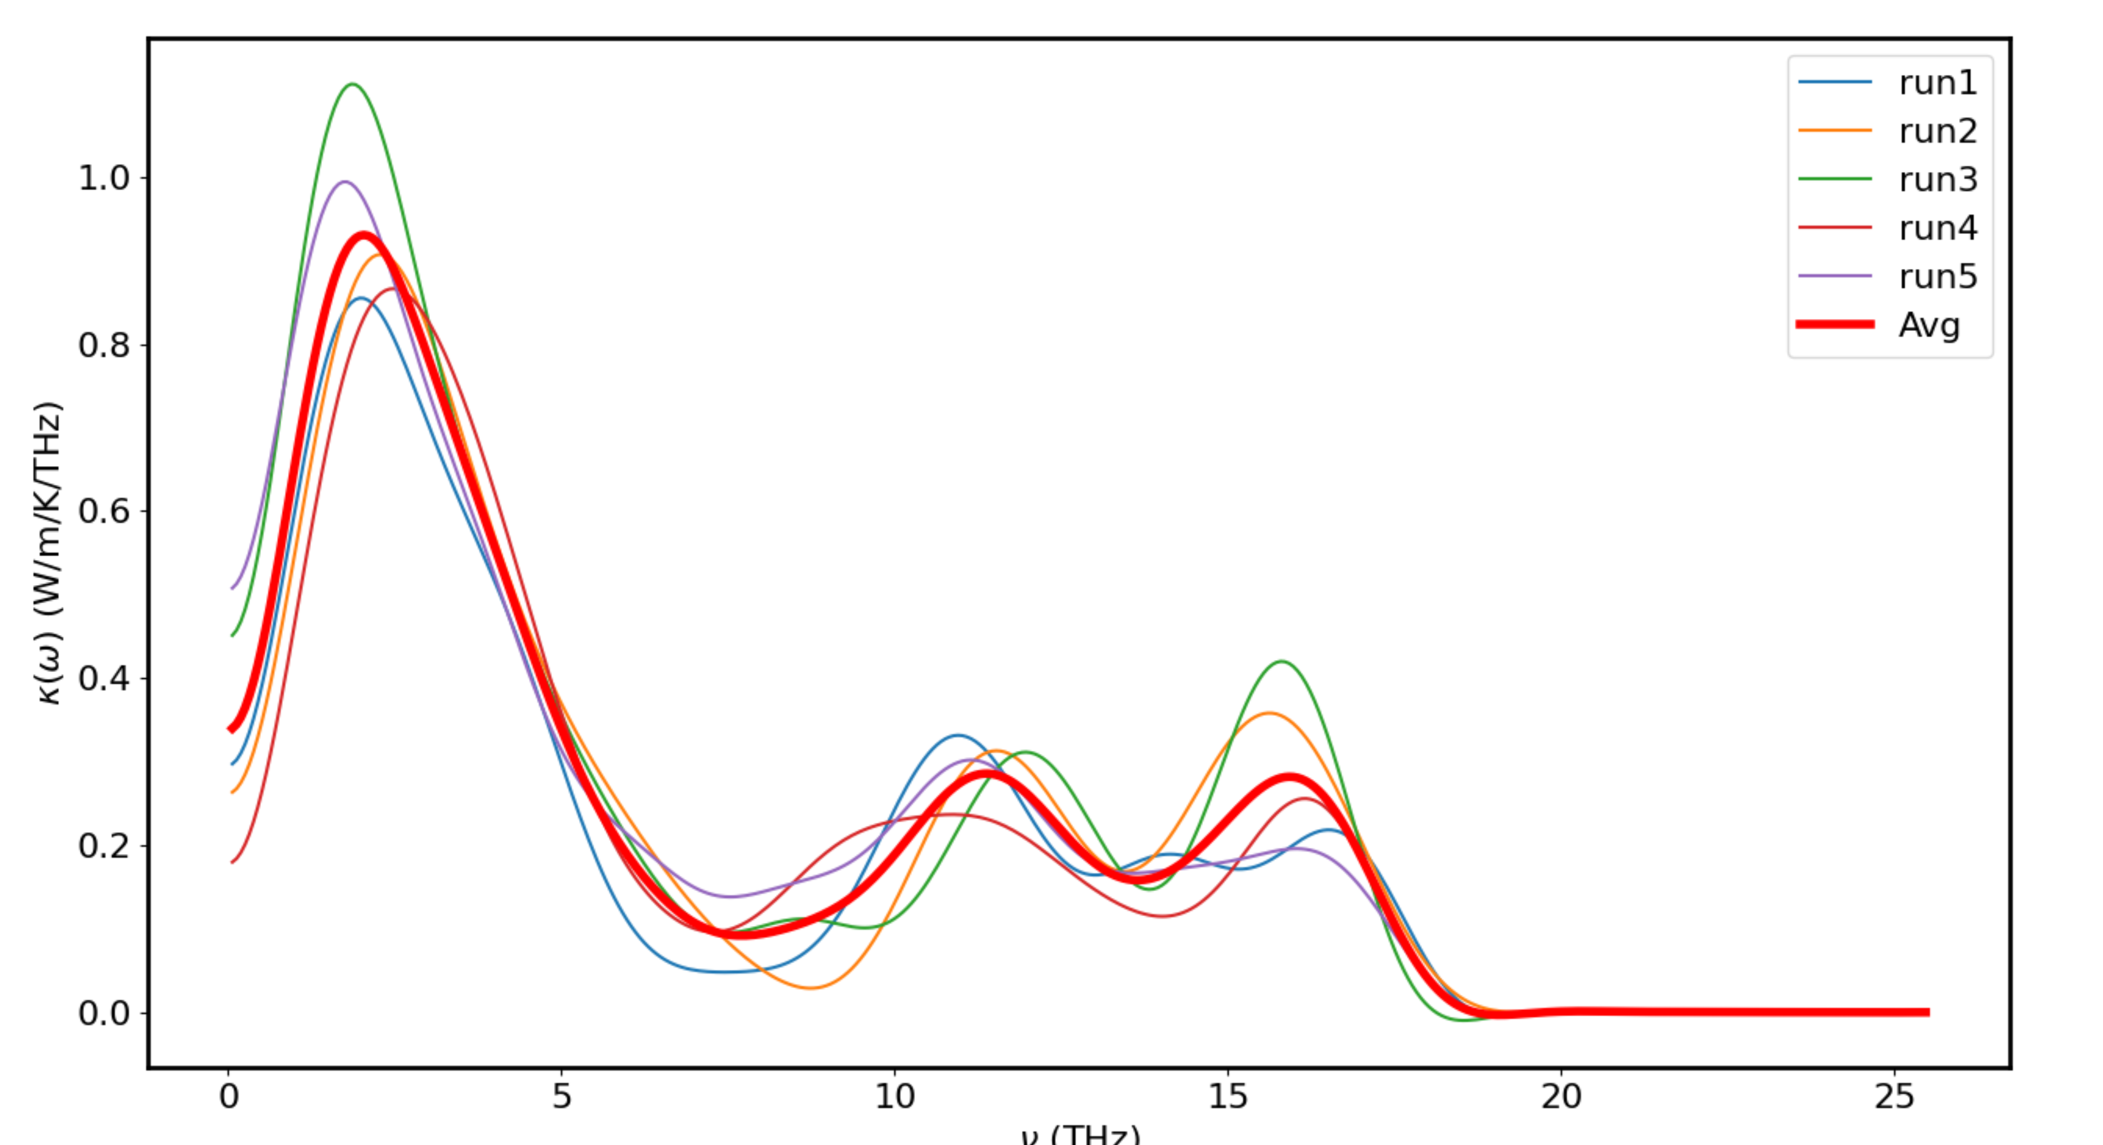
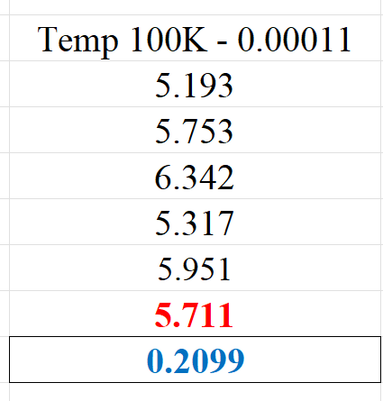
Temp 100K – F = 0.00011

Slide 29
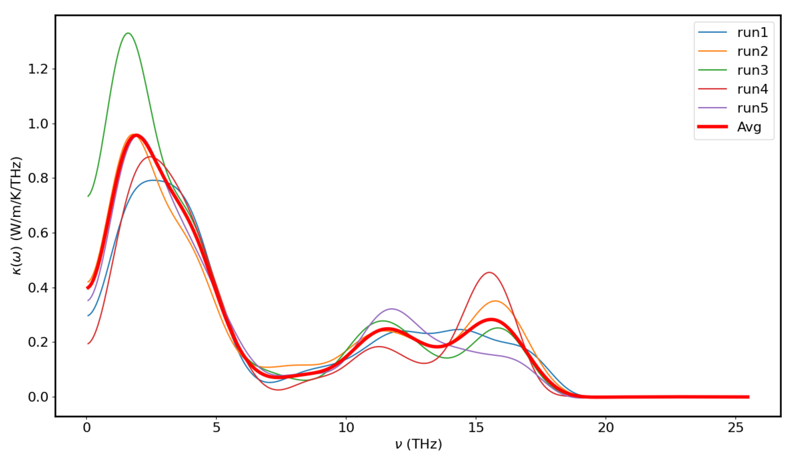
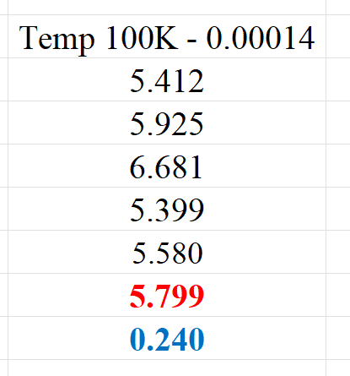
Temp 100K – F = 0.00014

Slide 30
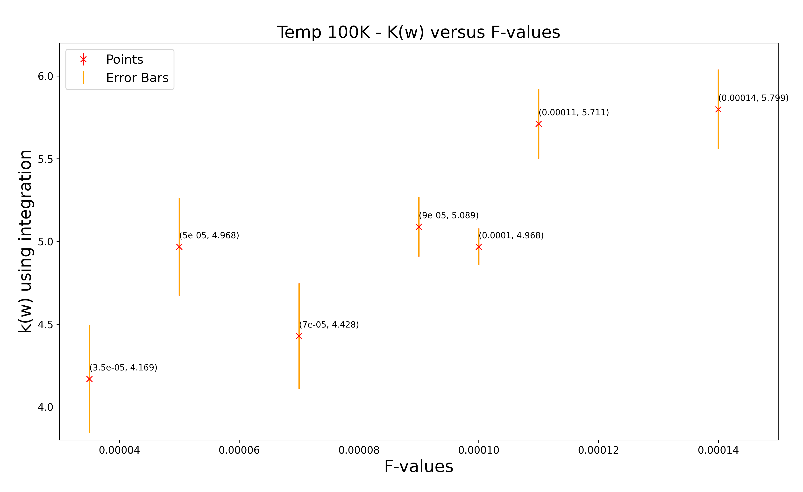
Plot of k(w) versus F-values for Temp = 100K
Thoughts: Optimize may be either around 0.00005 or 0.0001

Slide 31
TEMP 900K - Plot for F = 0.00014 with 5 runs

Slide 32
TEMP 900K - Plot for F = 0.0002 with 3 runs

Slide 33
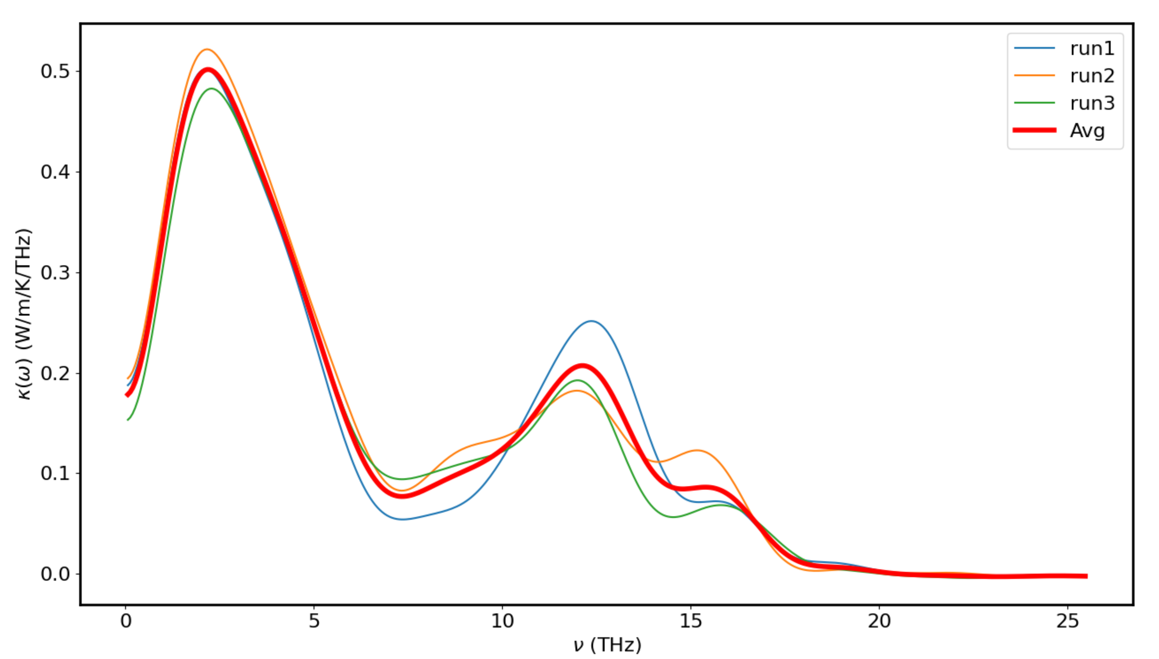

TEMP 900K - Plot for F = 0.0003 with 3 runs

Slide 34
TEMP 900K - Plot for F = 0.0004 with 3 runs

Slide 35


TEMP 900K - Plot for F = 0.0004 with 5 runs

Slide 36


TEMP 900K - Plot for F = 0.0005 with 3 runs

Slide 37


TEMP 900K - Plot for F = 0.0006 with 3 runs

Slide 38

Plot of k(w) versus F-values for Temp = 900K
Thoughts: Do more runs at 0.0004 to determine the optimize F-values

Slide 39

Possible Graph Fits for T vs F-optimized

Slide 40

Possible Graph Fits for T vs F-optimized

Slide 41


TEMP 500K - Plot for F = 0.00024 with 5 runs

Slide 42


TEMP 700K - Plot for F = 0.00032 with 5 runs

Slide 43

Plot K(w) versus Temp using Optimized F-values

Slide 44

3D Plot using Optimized F with all Temp

Slide 45

Temp = 100K – Avg Plot of lambda vs frequency (cut out the part that Gc or kw = 0 at after around 18THz)

Slide 46

Temp = 300K – Avg Plot of lambda vs frequency (cut out the part that Gc or kw = 0 at after around 18THz)

Slide 47

Temp = 500K – Avg Plot of lambda vs frequency (cut out the part that Gc or kw = 0 at after around 18THz)

Slide 48

Temp = 700K – Avg Plot of lambda vs frequency (cut out the part that Gc or kw = 0 at after around 18THz)

Slide 49

Temp = 900K – Avg Plot of lambda vs frequency (cut out the part that Gc or kw = 0 at after around 18THz)

Slide 50

MFP versus Temp using Optimized F for each Temp

